Slide 1

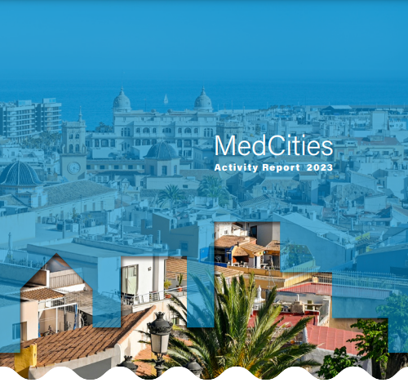

MedCities
Mediterranean Everyday Life Urban Planning - MELUP
Gender Perspective in Urban Development
International Study Visit on Green and Inclusive Urban Planning
Barcelona, 28th of April 2026

Slide 2

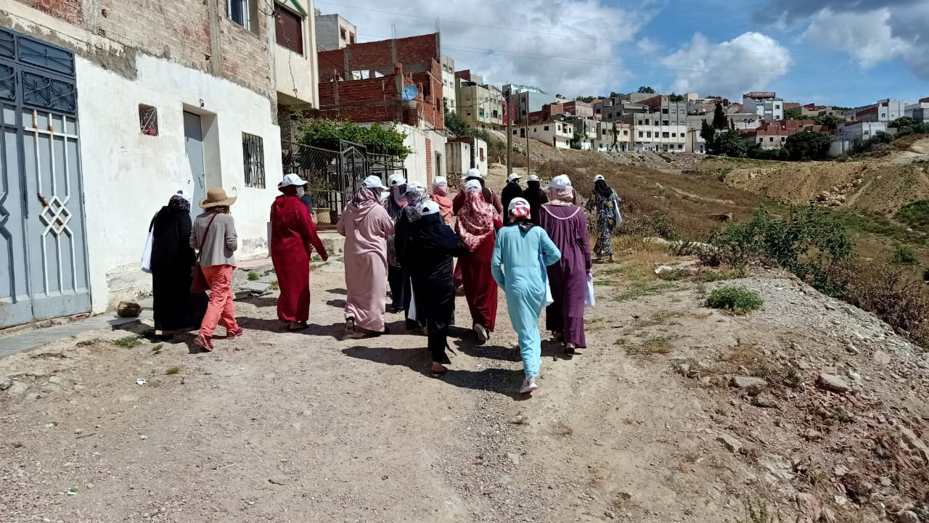
Project information
Dates
01/01/2025 – 31/12/2026
Budget
Project partners
Tripoli (LBN) and Al-Hoceima (MOR)
Previous experience
Tétouan (MOR), 2020-21, Participatory
Women’s Safety and Wellbeing Audit in
Nakatta neighbourhood
290.000 EUR. Managed by MedCities
ACCD: 231.760 EUR (79,92%)
MedCities: 43.240 EUR (14,91%)
Cities co-financing in HHRR (in kind contribution): 15.000 EUR (5,17%).

Slide 3
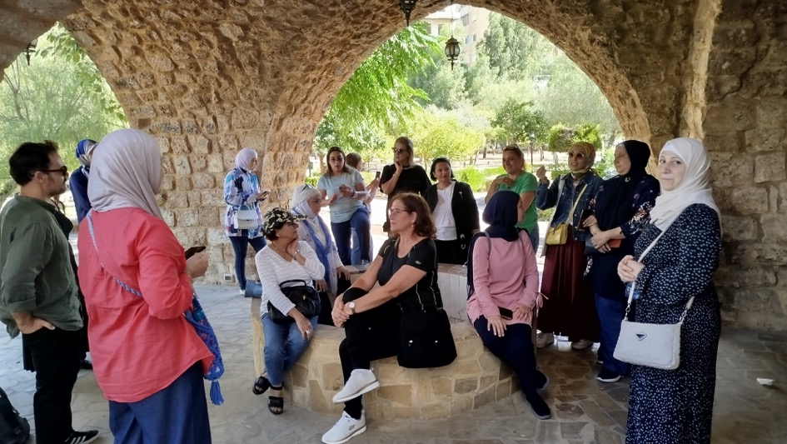
Objectives
General objective
To improve the quality of life and the inclusion of women in local public policies, ensuring the protection and fulfilment of their rights, in alignment with the 2030 Agenda and the MedCat 2030 Strategy.
Specific objectives
SO1. Promote inclusive and gender-responsive urban planning policies, in collaboration with local stakeholders and relevant public authorities, to safeguard women’s rights in urban development.
SO2. Strengthen the institutional capacities of local governments to integrate women’s needs, perspectives, and experiences into urban planning processes.

Slide 4
OE1. Promote inclusive urban planning
R1.1. Local administrations, in consultation with local actors, improve women's access to urban space adapted to their needs
1. Initial training on everyday life (gender-responsive) urban planning
Dates: September – October 2025
2. Participatory gender-sensitive diagnosis in a pilot neighbourhood
Dates: October – December 2025
3. Gender-responsive urban action plan
Dates: January – February 2026
4. Pilot interventions: Adaptation of a public space and soft intervention in the neighborhood
Dates: March – November 2026
Dissemination and awareness-raising activities
5. Final local seminar (transfer of results) targeting other municipalities and relevant stakeholders – policy dialogue
6. Inauguration event of the adapted space: local community awareness event
Dates: November 2026

Slide 5
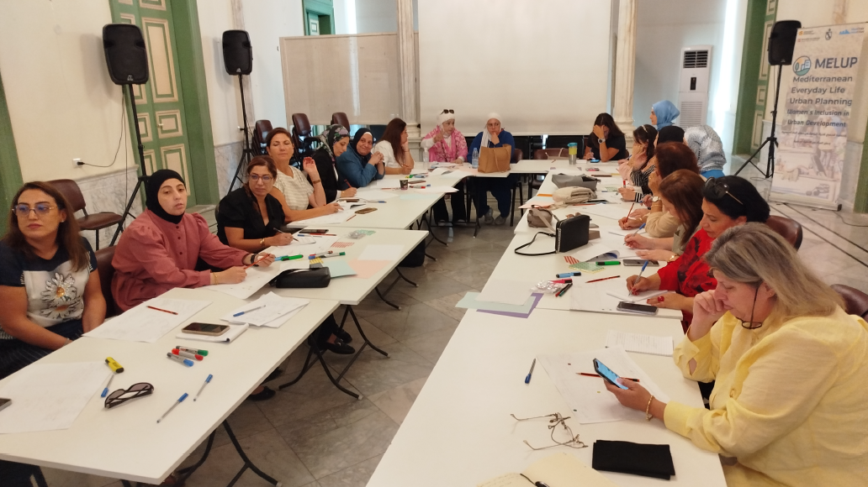
3 days training on everyday life (gender-responsive) urban planning
Concepts, tools, practices and experiences to integrate a gender perspective into urban planning
Toolkit to conduct participatory assessment:
Everyday life network mapping
Community mapping
Exploratory walks
Everyday life questionnaire
Body mapping
Al-Hoceima, 22-24th of September 2025, 18 participants:
11 municipal representatives, political & technical positions
7 representatives of CSO (women, family, children, people with
disabilities) + other national / regional administrations
Tripoli, 30th of Sept – 2nd of October 2025, 25 participants:
8 municipal representatives, political & technical positions
17 women representatives of CSO (women, family, children,
people with disabilities) + academia

Slide 6
Tripoli - Neighbourhood of Dahr El Moghr
Context: One of the most vulnerable areas of the city. Around 2.000 families in an area of 113,000 m2. Building collapse emergency since February 2026. Insufficient accessible and safe public spaces, particularly for women and children.
Diagnosis
Goal: to identify everyday life needs, safety and mobility issues, and access to public space of women and other underrepresented groups.
Key stakeholders: municipality, and local women’s and community-based associations (i.e. people with disabilities), 3 schools.
Participants profile (104) – intersectional approach:
Participatory activities:
Two participatory assessment workshops with a total of 16 women
Two neighbourhood observation visits combined with 68 intercept surveys
Two key informant interviews
Two exploratory walk with the group of women and young women

Slide 7
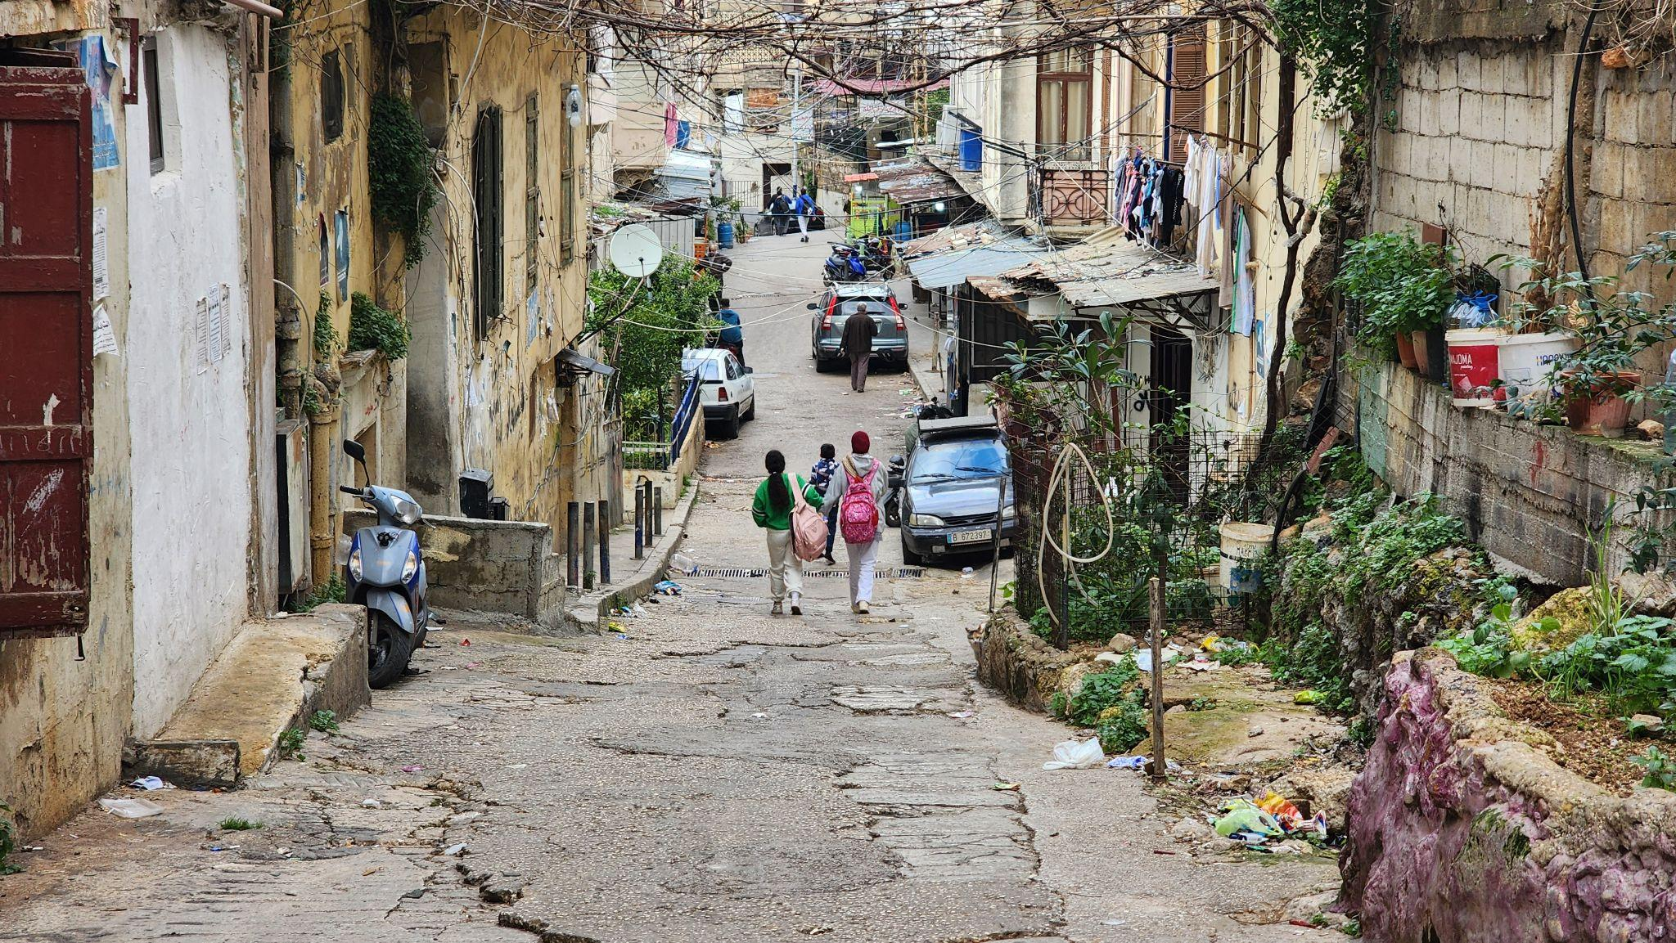
Key findings
Absence of safe, accessible, women and girls sensitive, and green public spaces for women and adolescent girls
Heightened vulnerability of women and girls to building collapse and emergencies
Limited awareness of safety procedures, housing rights, and reporting mechanisms
Urban layouts that hinder emergency response and access to services
Limited access to safe play and recreational spaces for children, increasing caregiving strain on mothers
Under-recognized women-led initiatives and informal neighborhood governance

Slide 8
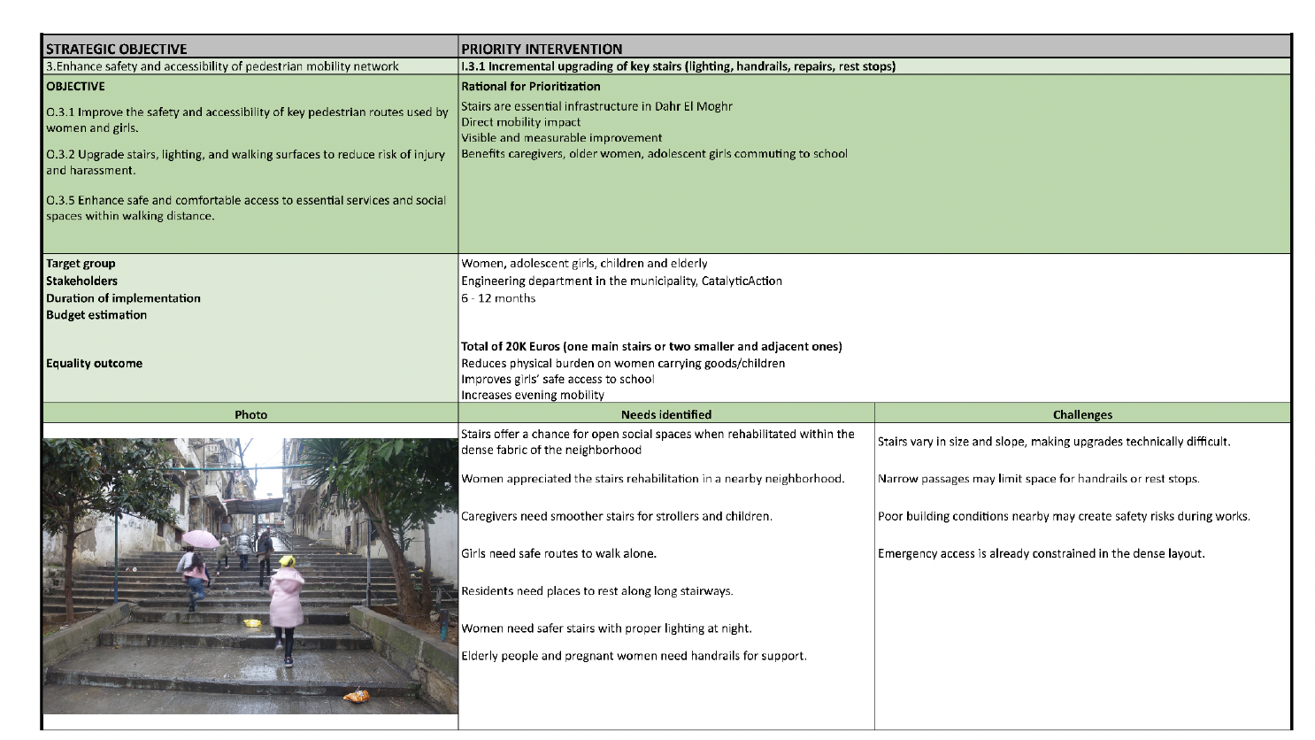
Action Plan
40 interventions under 6 main strategies were identified to improve different elements of the everyday life of women and girls in the neighborhood:
Create Inclusive, Women and Girls-Sensitive, and Green Public Spaces
Enhance Safety and Emergency Preparedness in the Built Environment
Enhance safety and accessibility of pedestrian mobility network
Create care-sensitive infrastructure and daily life needs
Support women-led community initiatives
Promote Inclusive Information Access and Rights Awareness

Slide 9
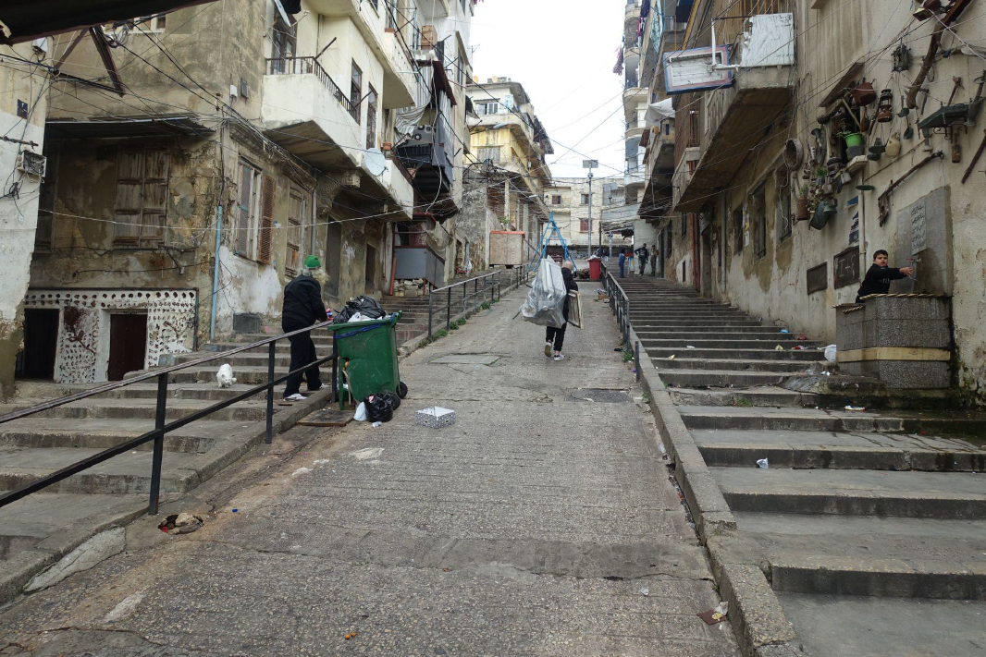
Pilot interventions
Incremental upgrading of a key stairway that connects two main roads and is heavily used by schoolgirls returning from a nearby school. The stairway offers sufficient spatial width to accommodate a range of small scale improvements, including lighting, shading, handrails, surface repairs, rest stops, and play opportunities (24.000 EUR)
A complementary soft intervention to establish a multi format community information system (e.g. icon based posters, information boards, and voice messages) aimed at improving women’s and girls’ access to trusted, clear, and locally relevant information on safety procedures, housing rights, evacuation steps, and available reporting mechanisms, addressing vulnerabilities heightened by building collapse risks and weak communication channels.

Slide 10
Al Hoceima – Sidi Abid neighbourhood
Diagnosis
Context: A densely populated neighborhood. Public college with 617 students.
Insufficient accessible and safe public spaces, particularly for women and children. Large female population.
Key stakeholders: municipality, and local women’s and community-based associations, ensuring an intersectional approach.
Participants profile (61):
Participatory activities:
One workshop of introduction to gender-responsive planning for women's associations working in various fields (women's rights, disability, elderly care, etc.), women living in the target neighborhood of Sidi Abid, and elected local women and municipal employees.
One workshop focusing on creating everyday life maps
One exploratory walk for adult women
One exploratory walk for young women (ages 16 to 25): high school students, university students, employees, trainees, women with disabilities, migrants, etc.
One participatory workshop to present the results of the assessment conducted with the women.

Slide 11
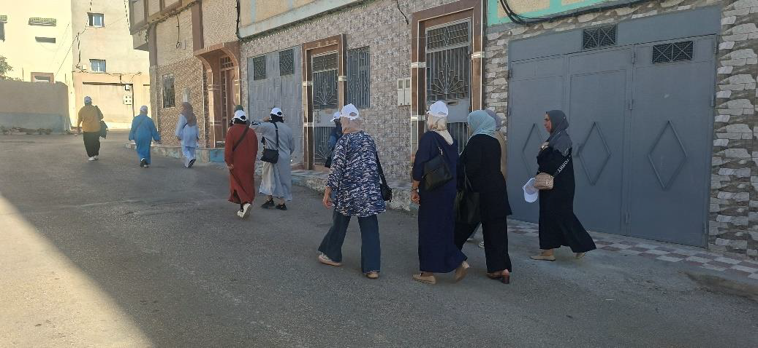
Key findings
Transportation emerged as a major and critical issue for the women residents, since they walk or take taxis, but there is no public transport system. In addition, the participants also highlighted the lack of school transportation.
Lack of sufficient and maintained public lighting.
Lack of basic services in the upper part of Sidi Abid, including a lack of food stores, distance from schools, lack of a daycare center and a health center, etc. Many of these services are located primarily in the lower part of the neighborhood.
Inexistence of parks, playgrounds and public spaces for women, children and young people
Lack of infrastructures of care that accompany everyday life activities, such as benches, lack of trees and shades, etc., also sidewalks are often too high.
Sexual harassment in public spaces was also discussed in open areas (in the upper part of the neighborhood).

Slide 12
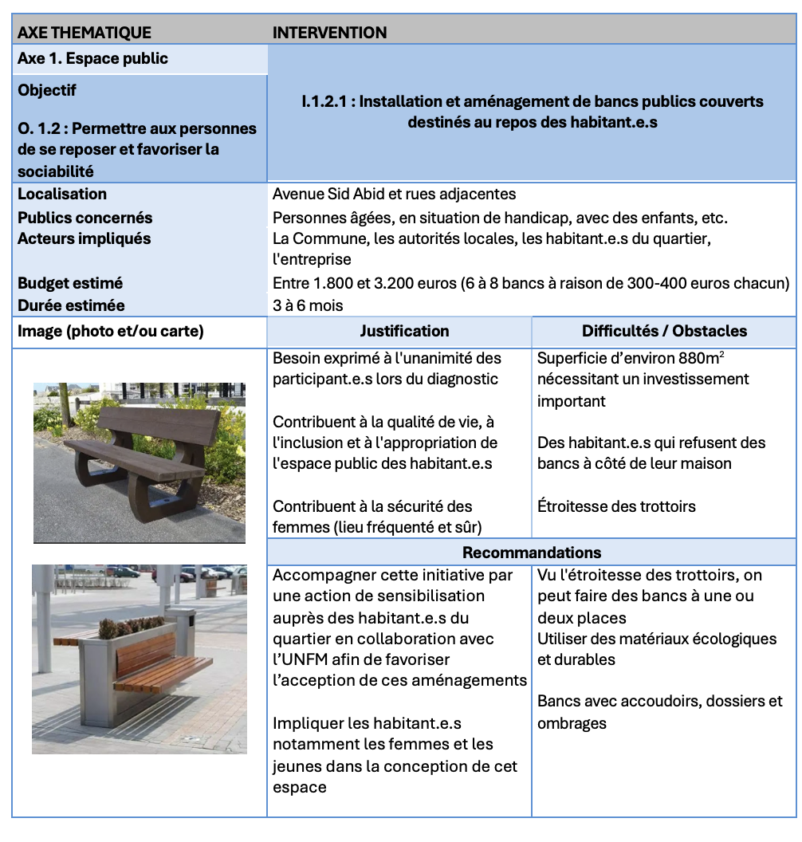
Action Plan
The gender-responsive participatory action plan identified 14 interventions under the following prioritized strategies:
Create a local green space (park) with a children's playground
Install public benches
Facilitate public transportation, especially for women
Improve sidewalk accessibility
Create sports facilities for girls and women
Plan the installation of essential services such as public restroom
Improve street lighting
Raise awareness about violence against women and women’s and girls' public safety

Slide 13
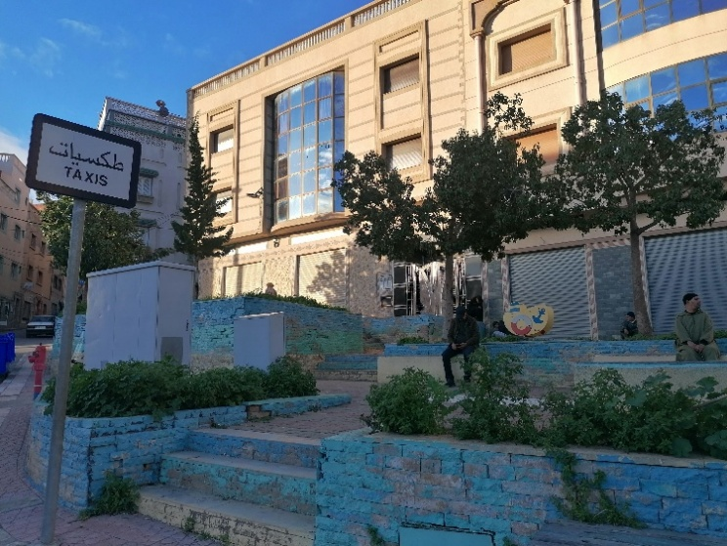
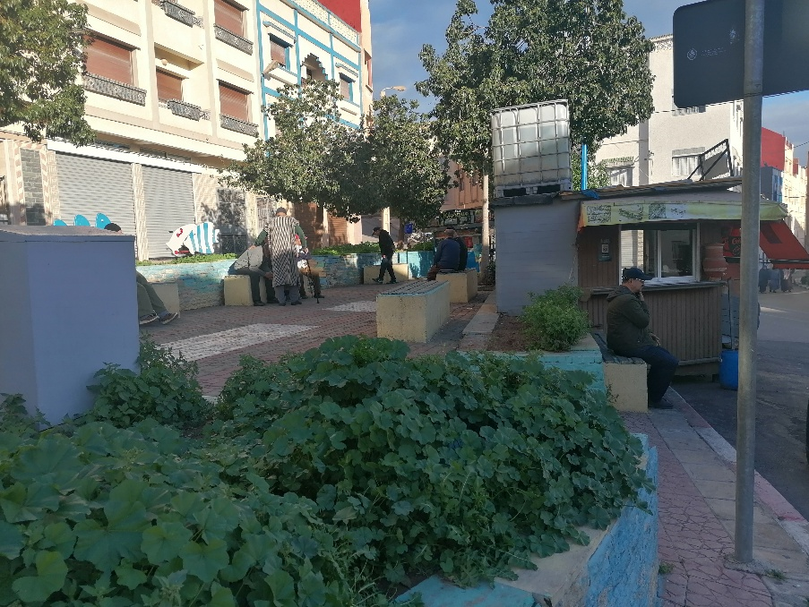
Pilot interventions
Redevelopment of the square and adjacent green space near the taxi rank (Jardins de Sidi Abid) has emerged as a key priority, with the objective of strengthening local meeting places and encouraging women and their children to actively use and take ownership of public space.
Installation and furnishing of covered public benches, providing residents with safe and comfortable places to rest.
Organization of awareness‑raising campaigns to address violence against women in the municipality’s four high schools.

Slide 14
OE2. Strengthening municipalities’ capacities
R2.1. The capacities of municipalities in promoting gender-responsive urban planning increase, as well as the links between Mediterranean cities through the exchange of good practices
1. Online peer –review on gender-sensitive urban planning policies with other MedCities members
Dates: May – June 2026
2. International study visit on inclusive urban planning, Barcelona
Dates: April 2026
3. South-South cooperation study visit on caring cities to Colombia
Dates: July 2026
4. Development of a guide on Everyday Life Urban Planning for Mediterranean municipalities (EN, FR)
Dates: May 2026
5. Final international online seminar on inclusive urban planning
Dates: November 2026

Slide 15
MedCities
Thank you!
Merci !
شُكْراً
Gràcies!
Gracias!
Noé Viedma
Project Officer
nviedma@medcities.org
www.medcities.org

