Slide 1







MedCities
Integrated Solid Waste Working Group 2025
Noé Viedma
9th of July 2025

Slide 2
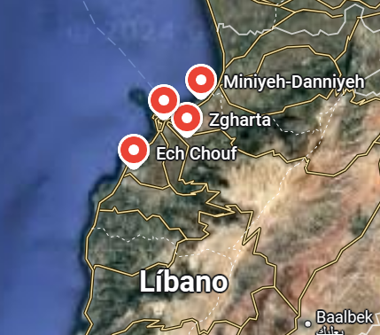
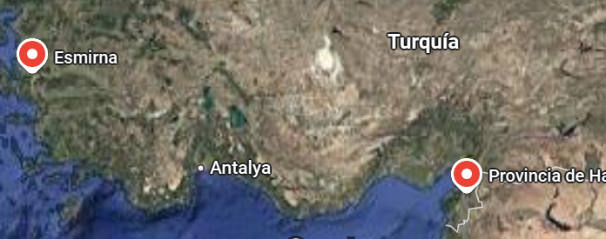
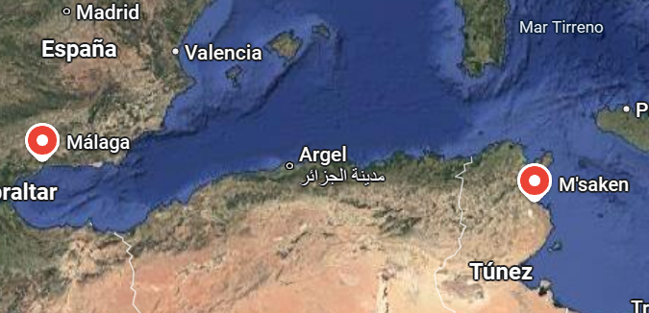
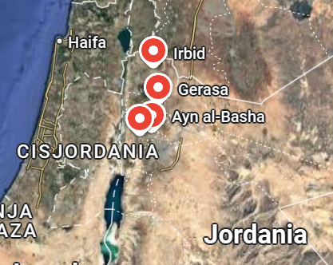
Working group members
Metropolitan City of Izmir
Türkiye
Al Fayhaa
Dannieh
Zgharta Ehden
Higher Chouf
13 members
6 countries
Metropolitan City of Hatay
Lebanon
Spain
Irbid
Málaga
As Salt
Jerash
Ain Al Basha
M’saken
Palestine
Tunisia
Bethlehem
Jordan

Slide 3

Activity report 2024
Webinar I: Key concepts, instruments and practical cases on waste treatment & disposal, finances and optimisation of waste transfer in the Mediterranean
Webinar II: Key concepts, instruments and practical cases on circular economy, waste prevention & reuse circuits, waste management planning and education & awareness
Study visit to Barcelona Metropolitan Area, December 2024 (Ain Al-Basha, Al-Fayhaa, As-Salt, Jerash, Higher Chouf, M’Saken)
Catalogue of 10 best practices and cases on waste management
List of relevant resources on waste management
Final report, including specific recommendations, and action plan 2025 https://drive.google.com/drive/folders/1LidMh1mwqa2EGlSOY0Oa7CPd2UilunyO
Notes:
Action Plan 2025: specific software and technologies

Slide 4


Action plan 2025
Webinar – “Introduction to the application of technology in municipal waste management”
📅 9 July 2025
🕥 10:30–12:30 CET
This session will introduce key concepts related to efficient waste management models and explore relevant technological solutions applicable to the sector.
2. Training Webinar – “Decision Support Web Tool (DSWT) for Urban Biowaste Systems” – Register here
📅 15 July 2025
🕙 10:00–13:00 CET
This session will focus on a free-to-use IT tool that assesses biowaste and residual waste management systems across the three pillars of sustainability: environmental, economic and social.
3. Mentoring Programme – “Supporting the Implementation of the DSWT in Three Municipalities”
📅 October–November 2025
ENT will provide tailored bilateral support to three municipalities that participate in the webinars, guiding them through the implementation and use of the IT tool.
4. Webinar on waste management and circular economy projects in the framework of the GiZ Libya project (tbc)

Slide 5

Transferring Innovative Solutions for local authorities to abate land-based sources of marine pollution in the Mediterranean
Please register using the following link: https://us06web.zoom.us/meeting/register/qMf-JwFETGiS3MvjgQaikw

Slide 6
MedCities
Thank you!
Merci !
شُكْراً
Gràcies!
Gracias!
Noé Viedma
Project Officer
nviedma@medcities.org
www.medcities.org

