Slide 1
Dubrovnik:
Financing the Renewal of Historical Buildings
Andro Vlahušić,
Mayor of Dubrovnik

Slide 2
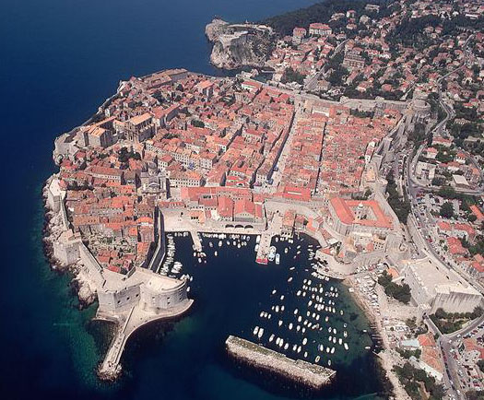
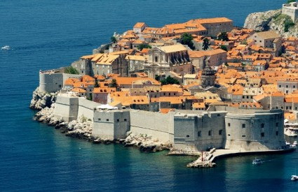
Preserving the Way of Life
The astonishing city of stone is surrounded by stone walls 1,940 m in length
One of the most grandiose fortification monuments in Europe
The first fortifications were built already in the 8th century, but the most intense construction took place from the mid-15th to the end of the 16th century
The main wall has 18 fortifications, 4 bastions and 3 entrances to the city ramparts

Slide 3
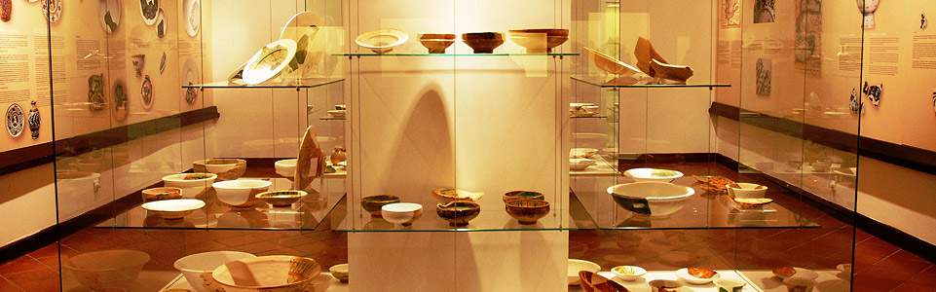
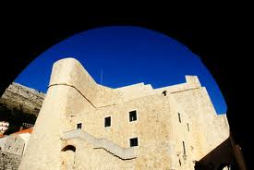
Fort Revelin
The fort Revelin protected both the eastern part of the City from mainland and the entrance to the City Harbour. The lower part of the fort was built in 1463, in the shape the City model held by St. Blaise
The fort contains a permanent exhibition of the Museum of Archeology, as well as a virtual museum.
Fort Revelin was completely renovated from 2002-2004

Slide 4
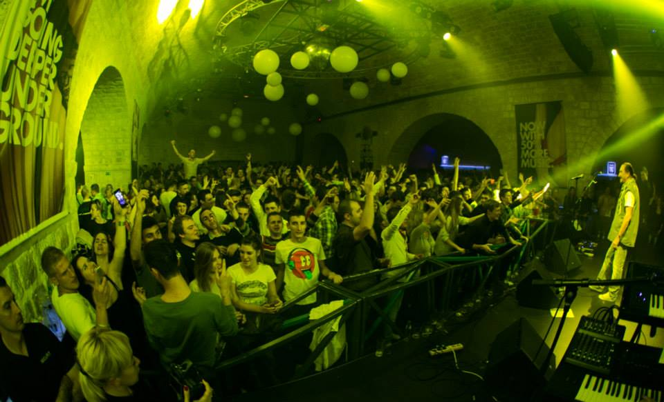
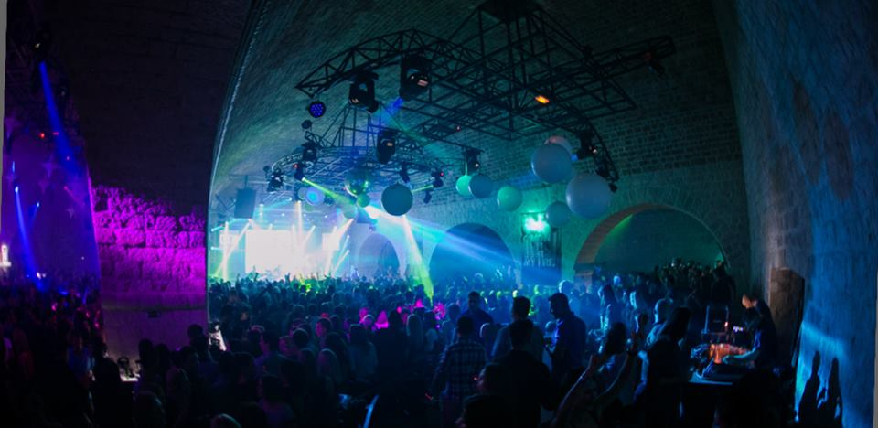
Revelin Night Club
In the evening hours, the fort is transformed into a night life scene
The Revelin Culture Club opened in December 2010. Since then, it has hosted many famous Croatian pop stars, as well as many foreign artists. The club continues to organize various programs for all the residents and many tourists of Dubrovnik
The annual revenue from rental and tickets for the City of Dubrovnik is about 500.000 Euros

Slide 5
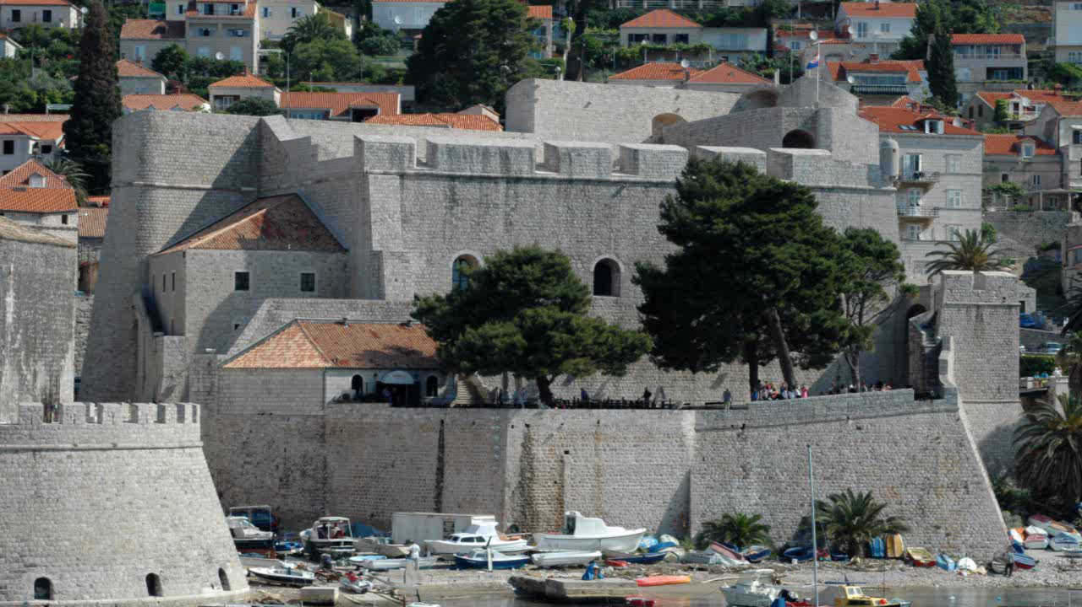

Slide 6
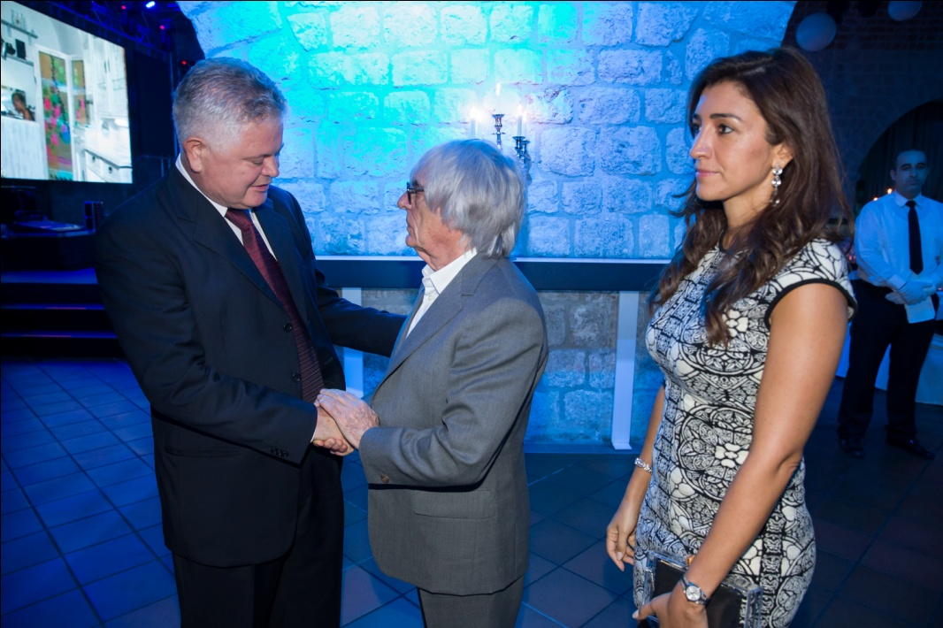
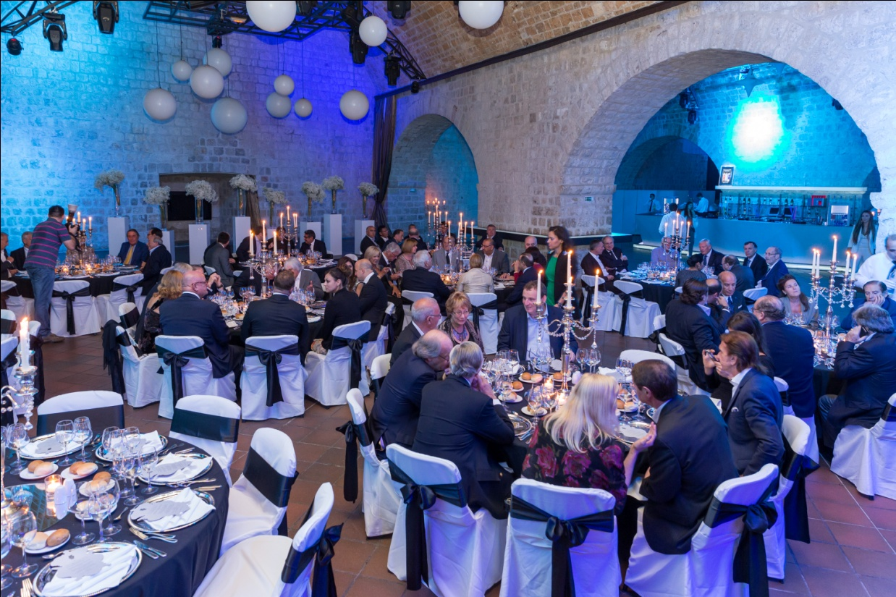
In addition to its impressive interior space, Revelin has the ability to transform itself from a night club to a magnificent venue for VIP events and Gala Dinners
Revelin has a beautiful top-terrace with a spectacular view of Dubrovnik, where many events are held during the Dubrovnik Summer Festival and many other events
The annual number of visitors is approx. 250.000

Slide 7
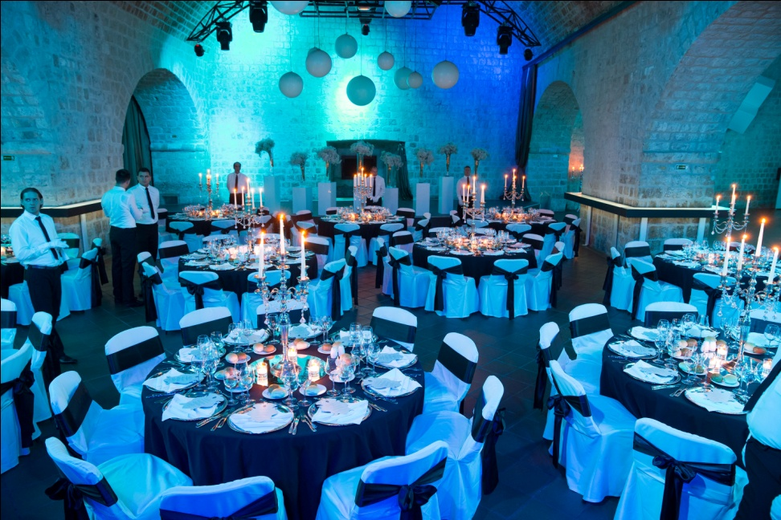
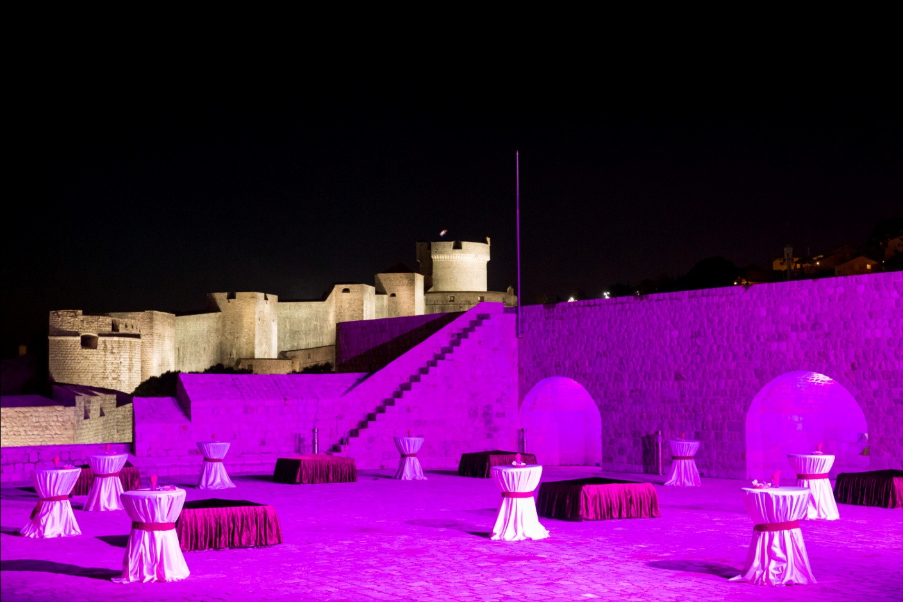
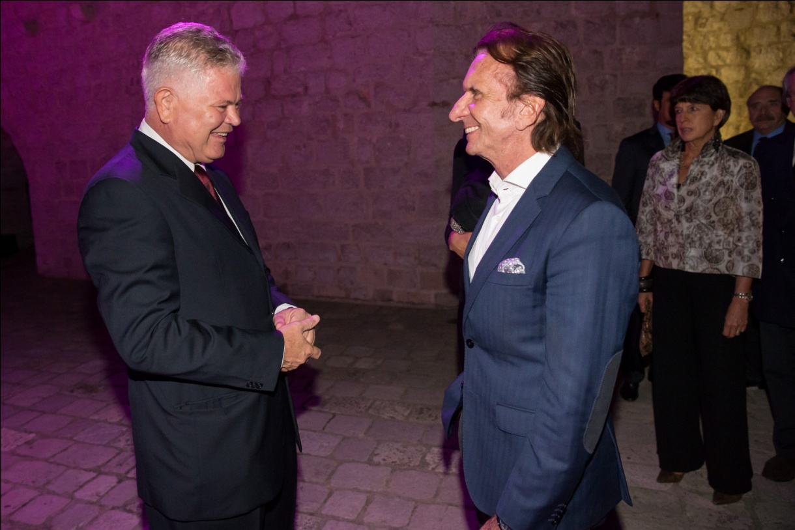
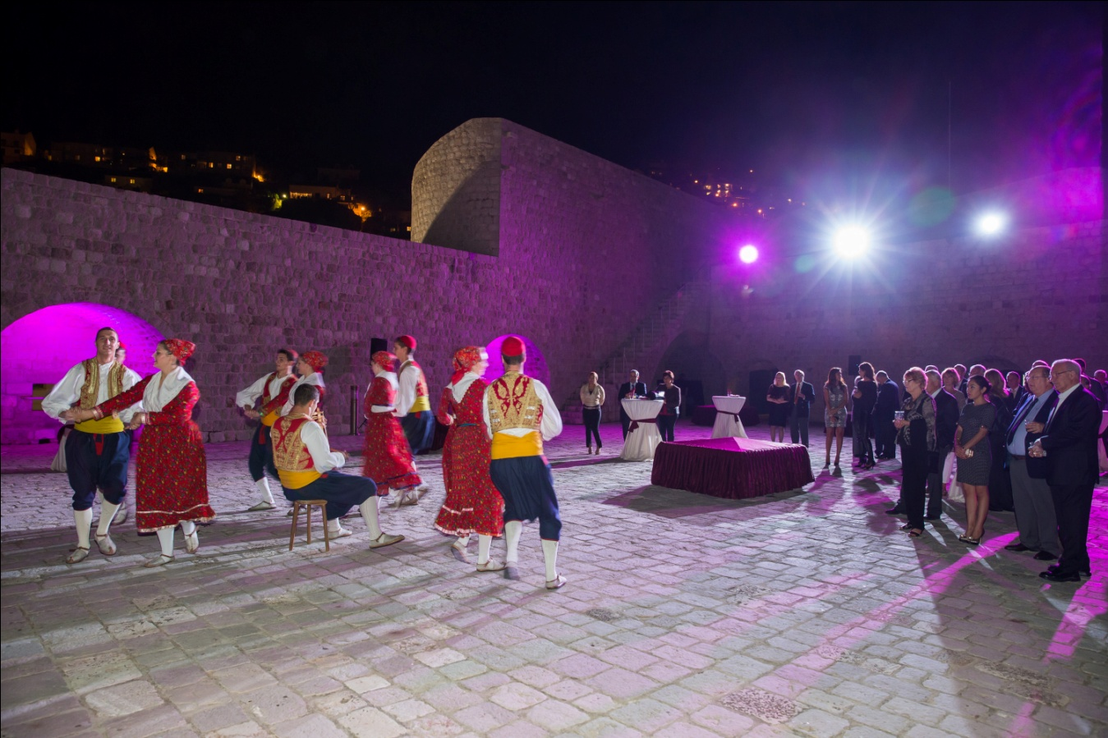
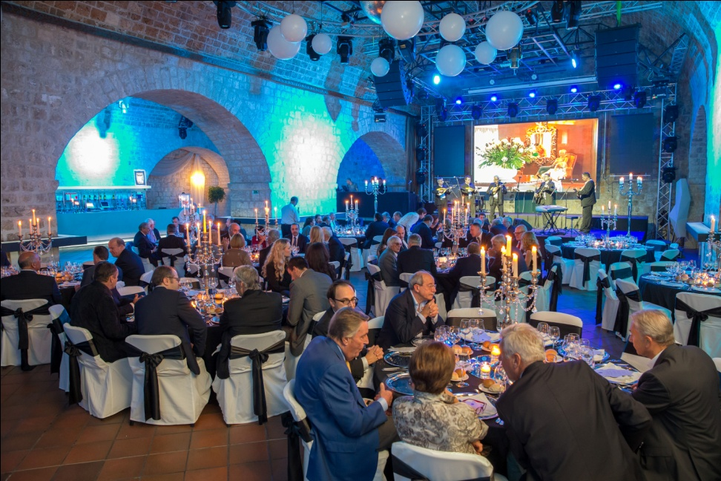

Slide 8
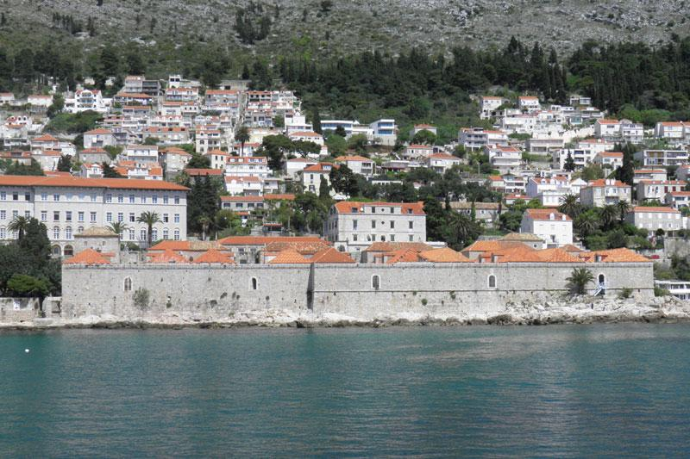
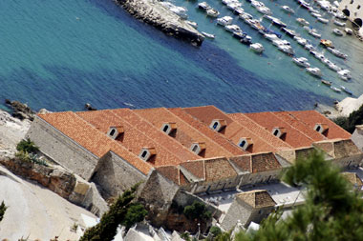
Lazareti
The first quarantine was built at Ploče as early as 1377 for the purpose of isolating the travelers and goods from eastern countries, where outbreaks of contagious diseases were frequent
The complex included large warehouses for goods and livestock, as well as lodgings for the extended isolated stay of merchants and travelers
Today, the Lazareti serve manifold purposes such as recreation, trade and entertainment

Slide 9
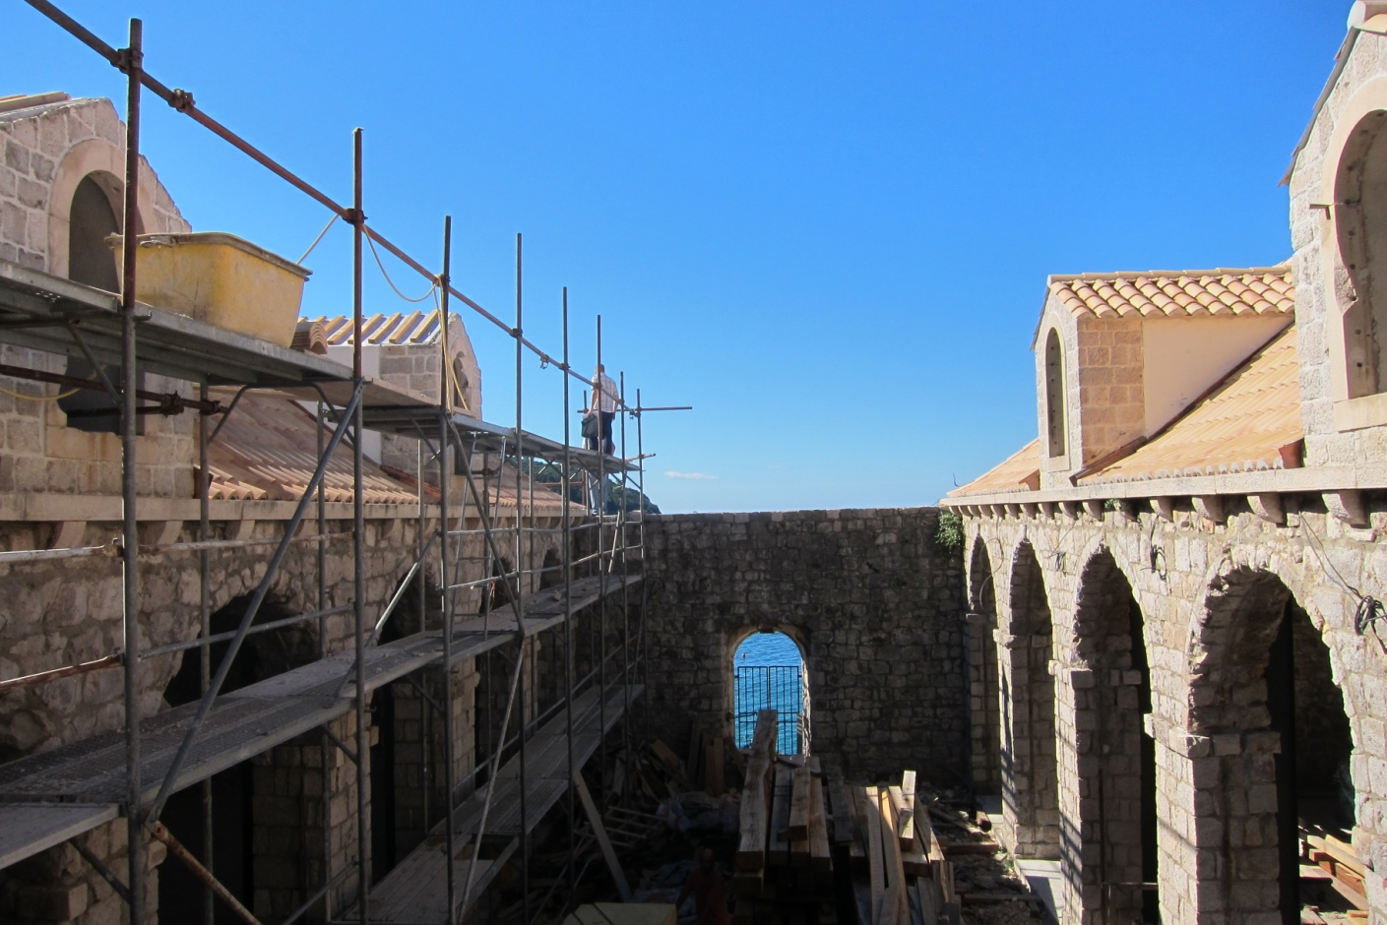
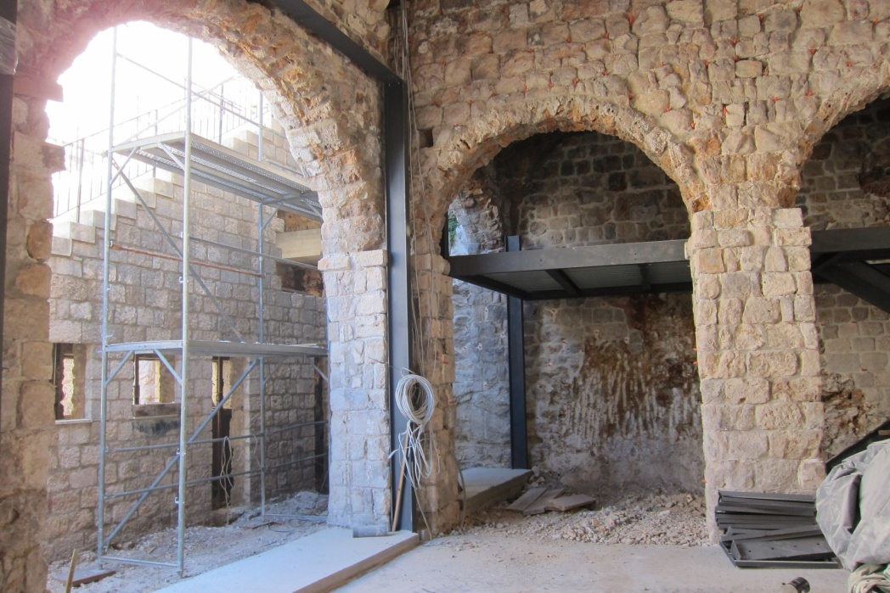
The Reconstruction of Lazareti
Revenues from Fort Revelin initiated the reconstruction of Lazareti
The 4 mil Euro reconstruction started in October 2012
Phase I is to be completed by spring
After reconstruction, the Lazareti complex will acccommodate civil society associations and cultural institutions, such as the Symphony Orchestra and Linđo Folklore Ensemble, as well as for various other civil society and social events, ie. the organization of congresses

Slide 10
In Conclusion
A Ruling to place historical buildings at the service of citizens and visitors
Over 350,000 people are expected to visit Fort Revelin and Lazareti annually
Sustainable development – self-financing
Civil Society usage
Commercial purposes
Promotion of historic Dubrovnik

Slide 11


