Slide 1
mediterranean network for the promotion of sustainable urban strategies and the three new urban development strategies
USUDS Project
Larnaca
Andreas Karakatsanis
Chief Municipal Engineer
Larnaca Municipality
ENPI-CBC MED

Slide 2
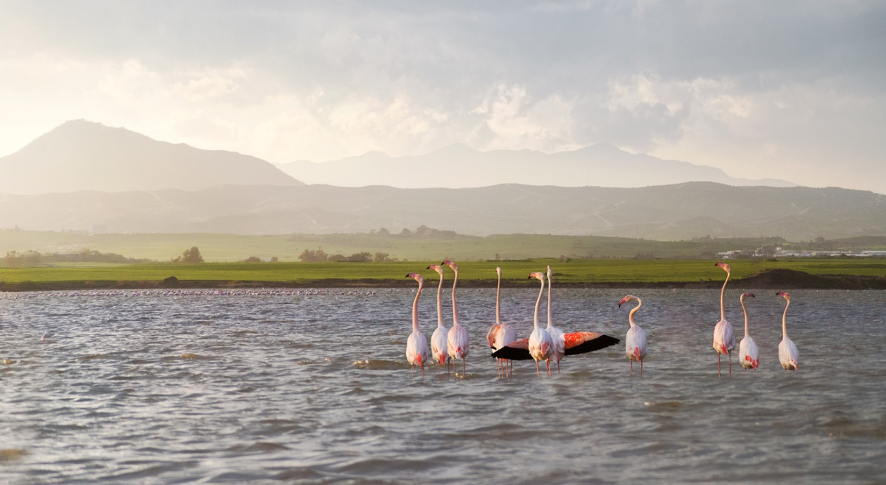
USUDS
CREATED BY USUDS TEAM, 19/11/2013
information on Larnaca

Slide 3
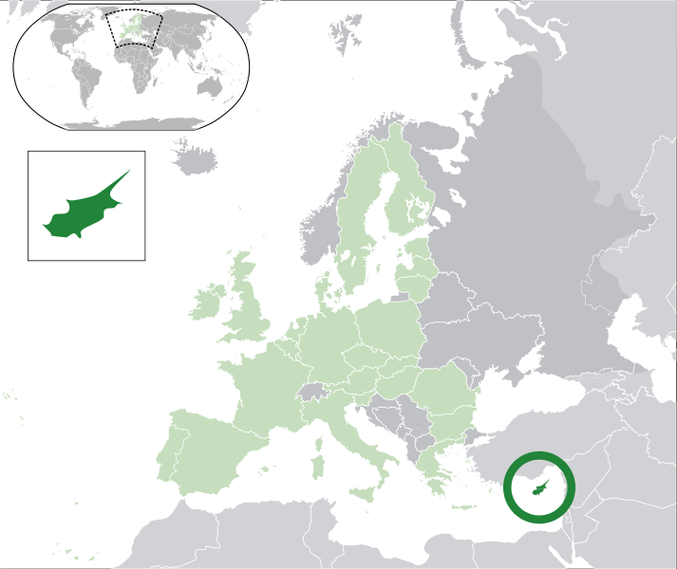
CYPRUS
CREATED BY USUSDS TEAM, 19/11/2013
Strategic location at the crossroads of 3 Continents
Member of the EU since 2004
Member of the Euro zone since 2008
Europe’s South - Eastern frontier

Slide 4
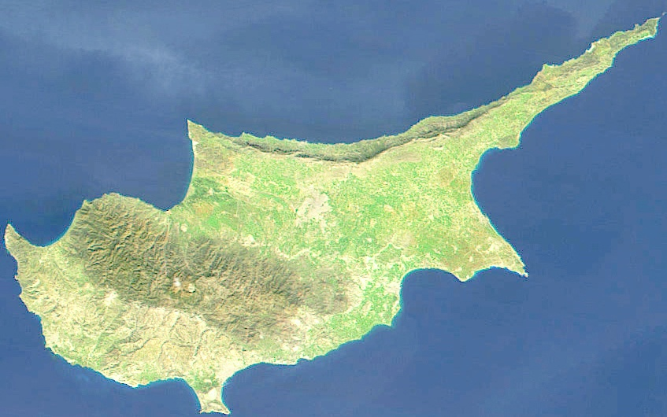
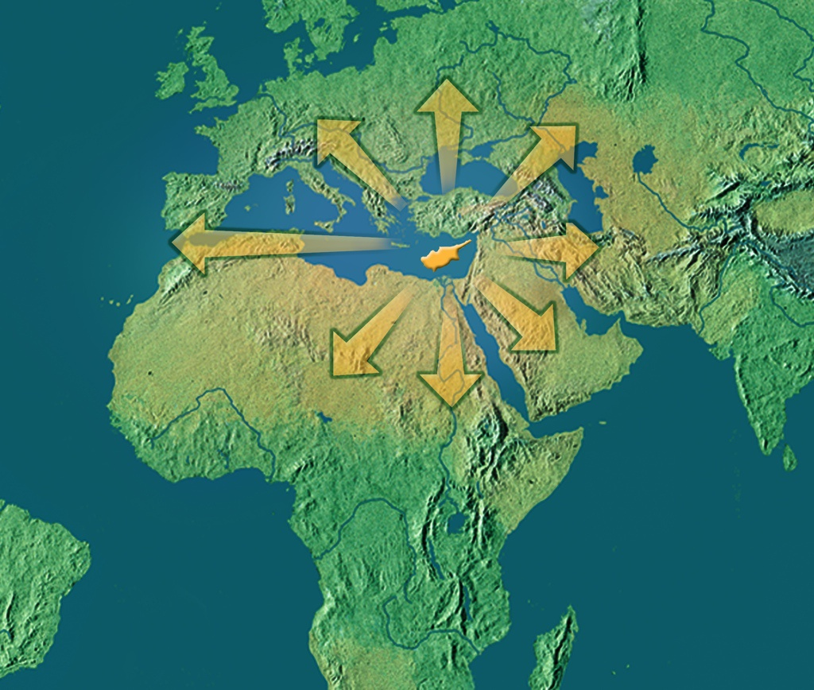
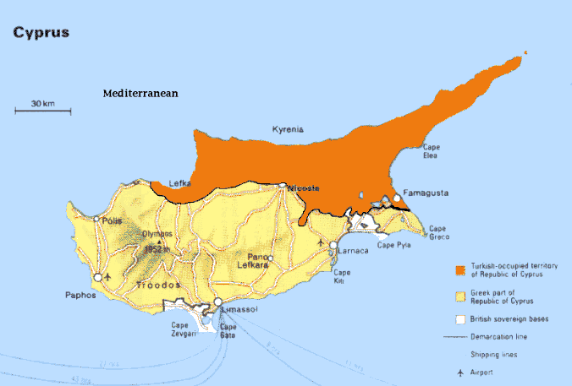
CYPRUS excellent location
CREATED BY USUDS TEAM, 19/11/2013
Third largest island in Mediterranean
Area 9248 km²
Population 800000
Divided since 1974

Slide 5
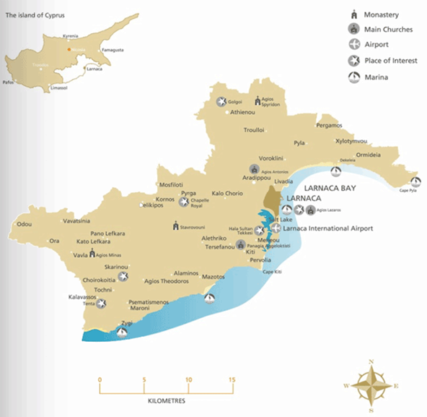
LARNACA district
CREATED BY USUDS, 19/11/2013
Larnaca District area [1.393km²]
Larnaca District population [150.000]
Mediterranean coastline [75Km]
Morphology – Highest mountains:
  Odou 1.234m
  Vavatsinia 939m
  Stavrovouni 688m
75 Km of Mediterranean coastline

Slide 6
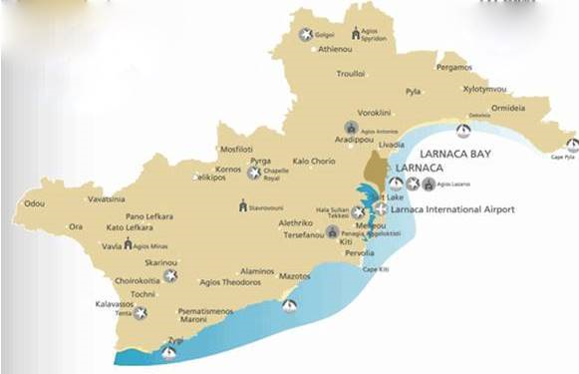
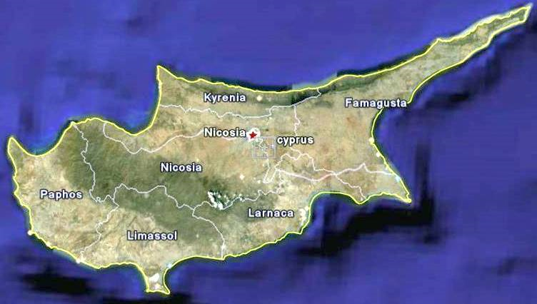
LARNACA
city
CREATED BY USUDS TEAM, 19/11/2013
The third largest city & region in Cyprus
One of the oldest cities / regions in Europe
Big enough to offer every amenity, but still relatively uncrowded

Slide 7
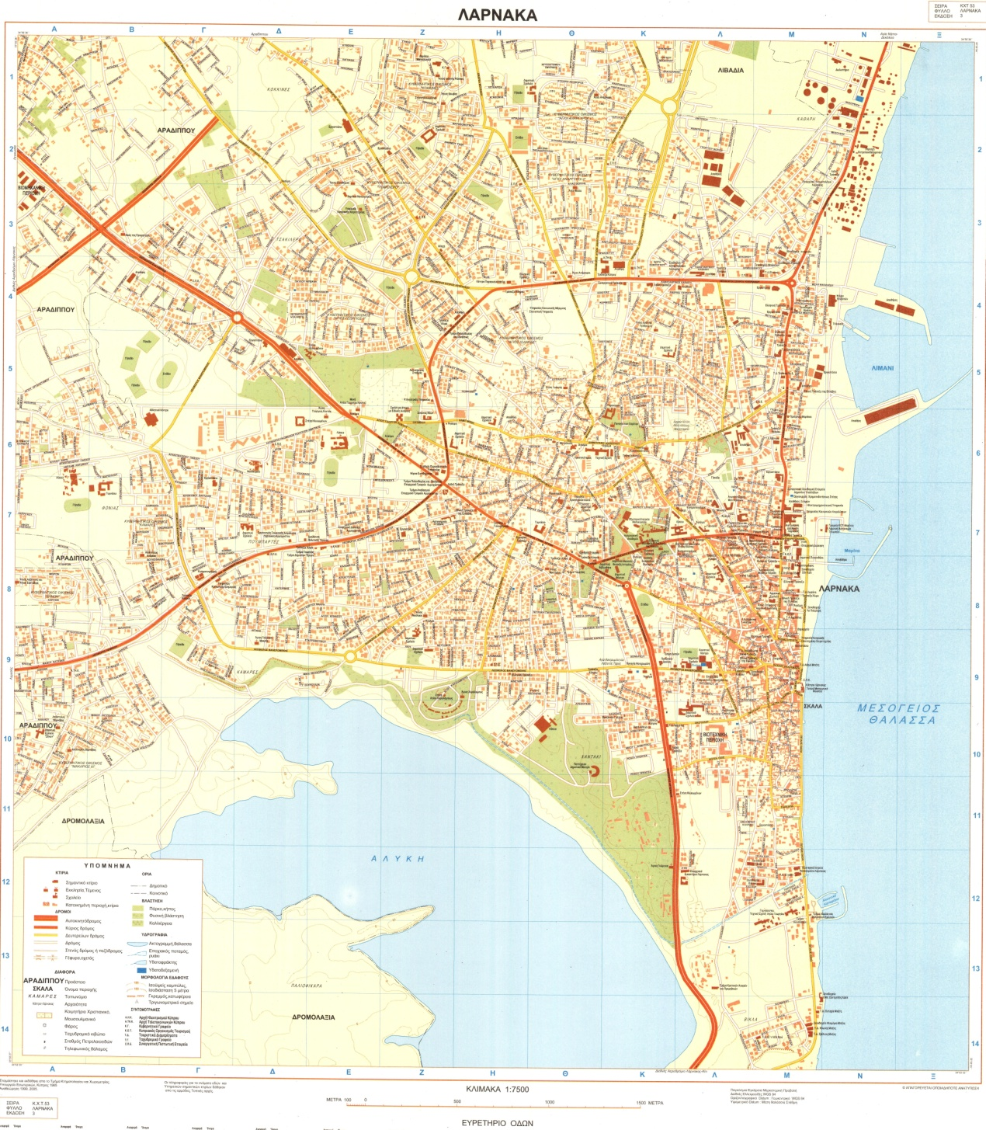
LARNACA
Area 32.5 km²
Population 80000
Relatively flat
2nd Largest Port
Main Marina
Main Airport
Salt Lakes

Slide 8
LARNACA Challenges / Opportunities
In Transition
Looking for new identity
Great potential for development
Leadership for bold decisions
Economic crisis

Slide 9
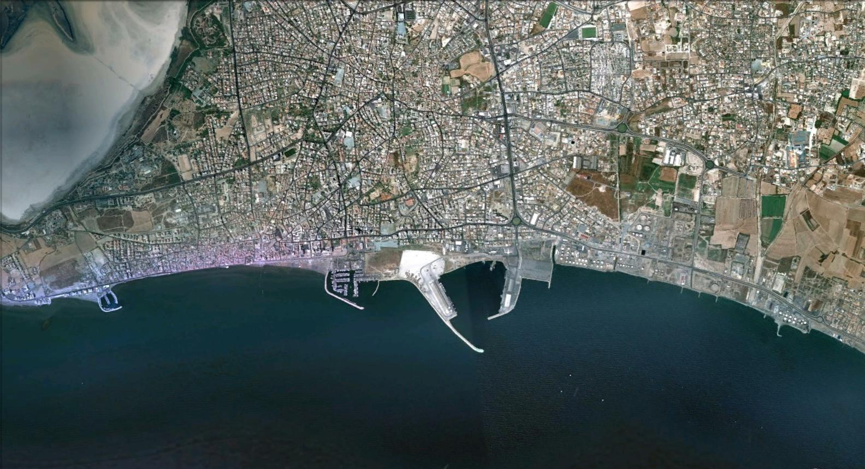
LARNACA and the sea

Slide 10
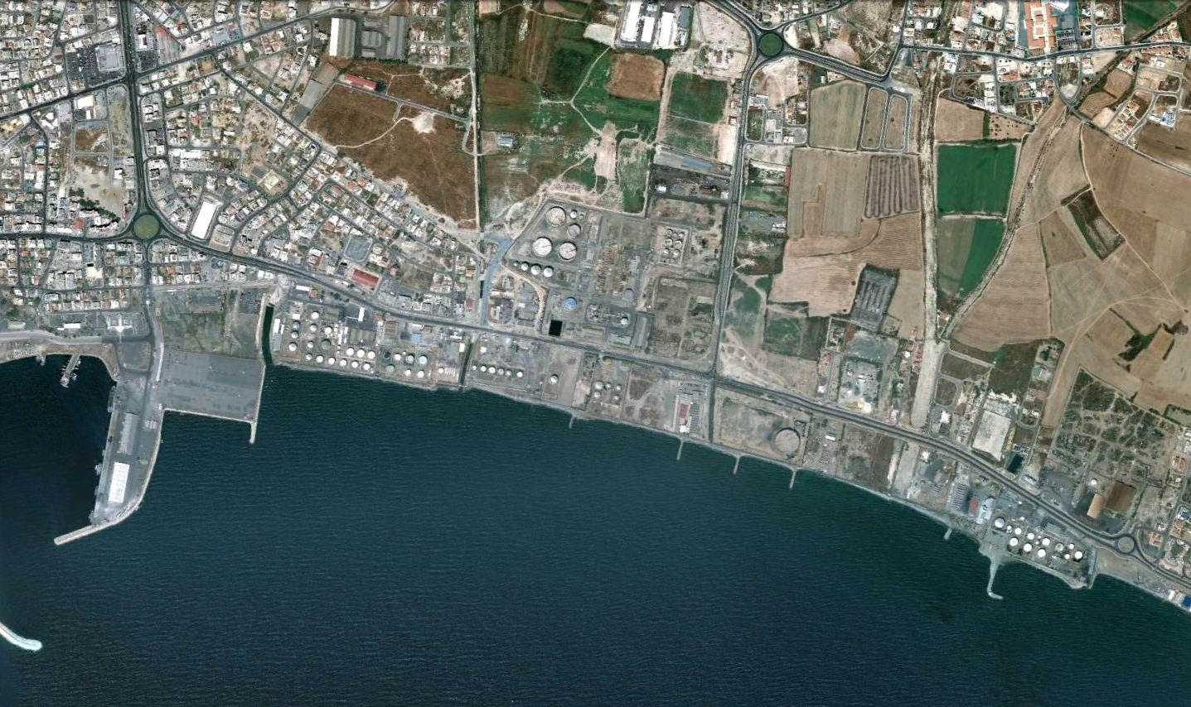
industrial area

Slide 11
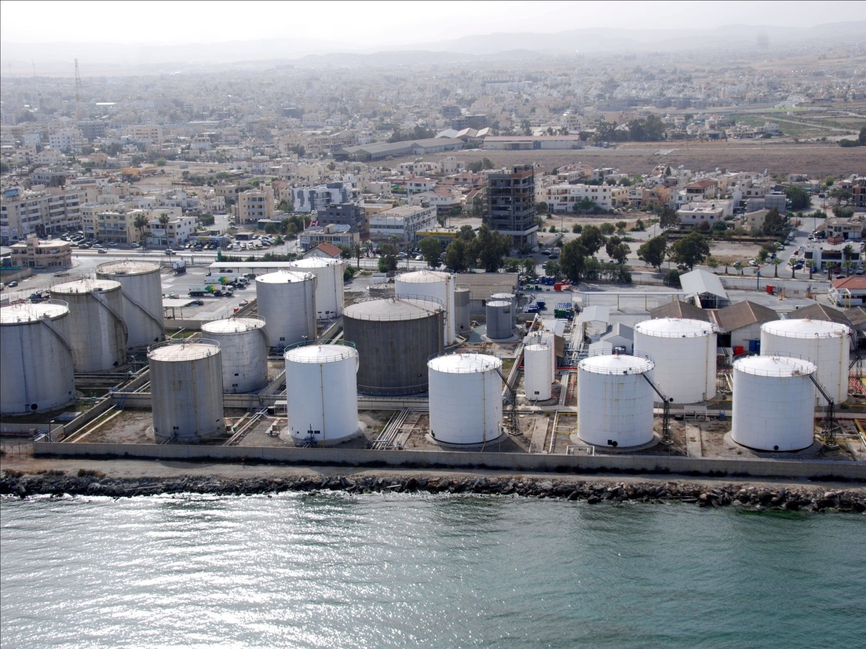
industrial area

Slide 12
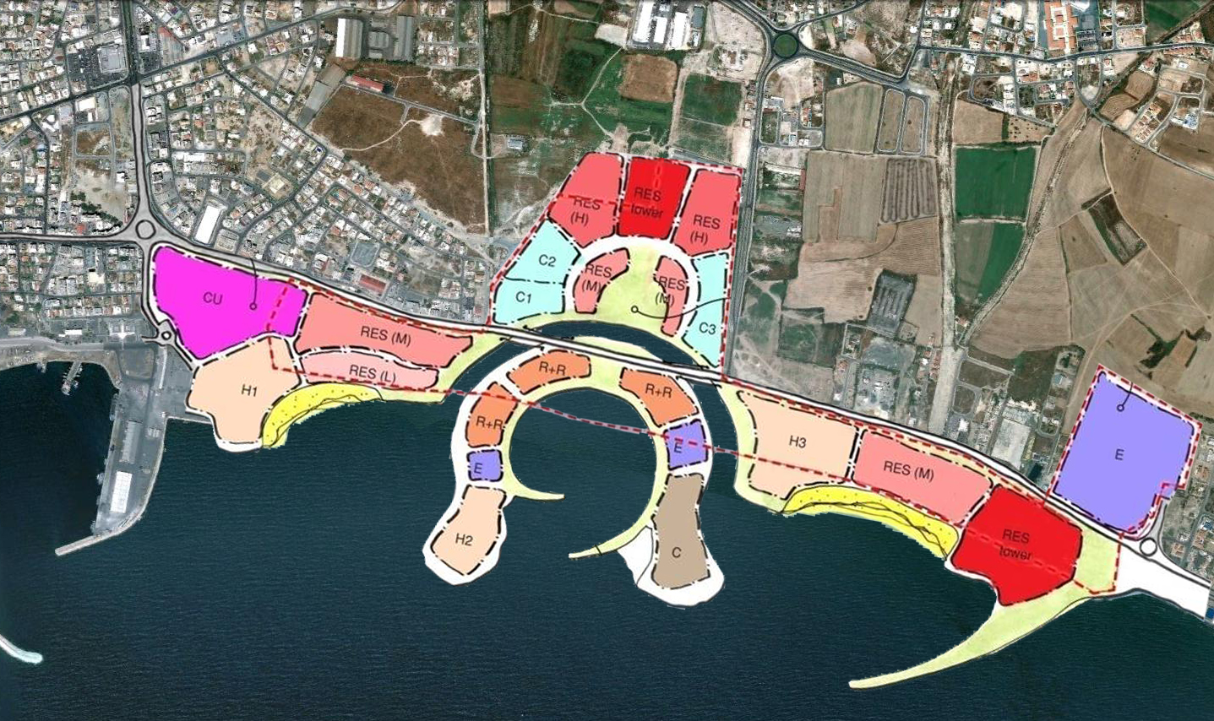
industrial area

Slide 13
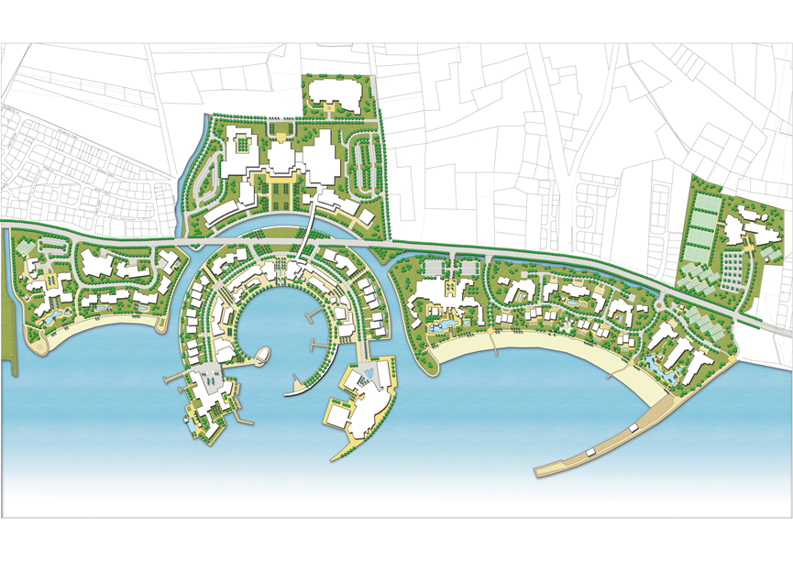
industrial area

Slide 14
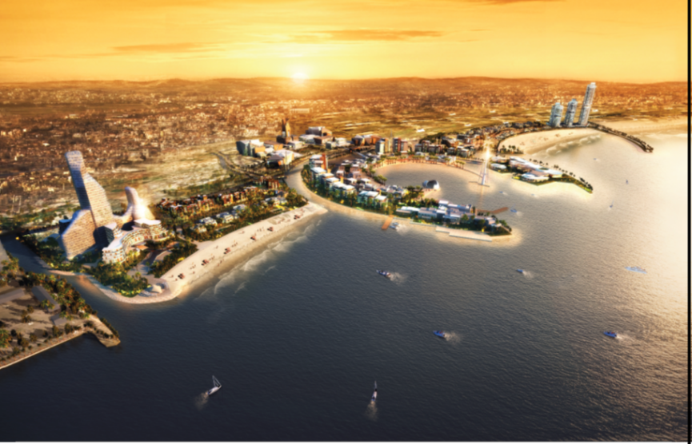
industrial area

Slide 15
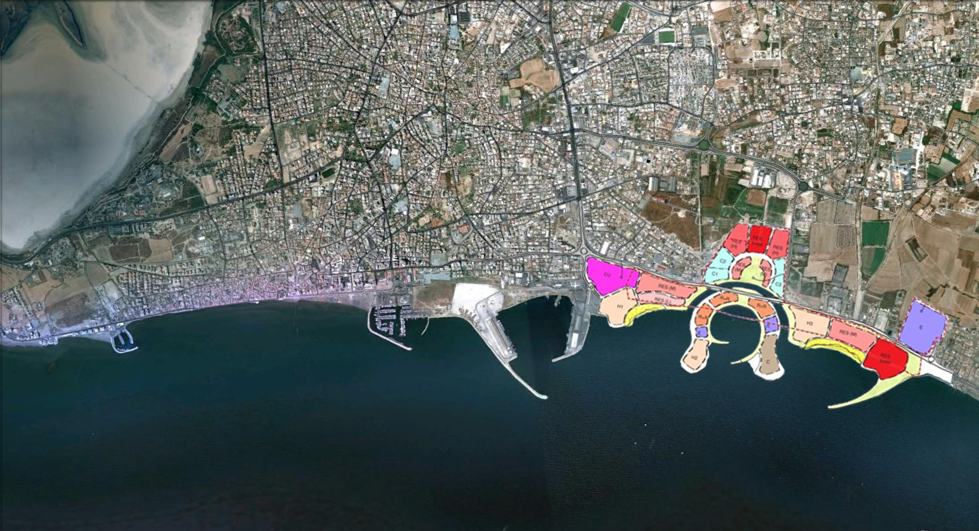
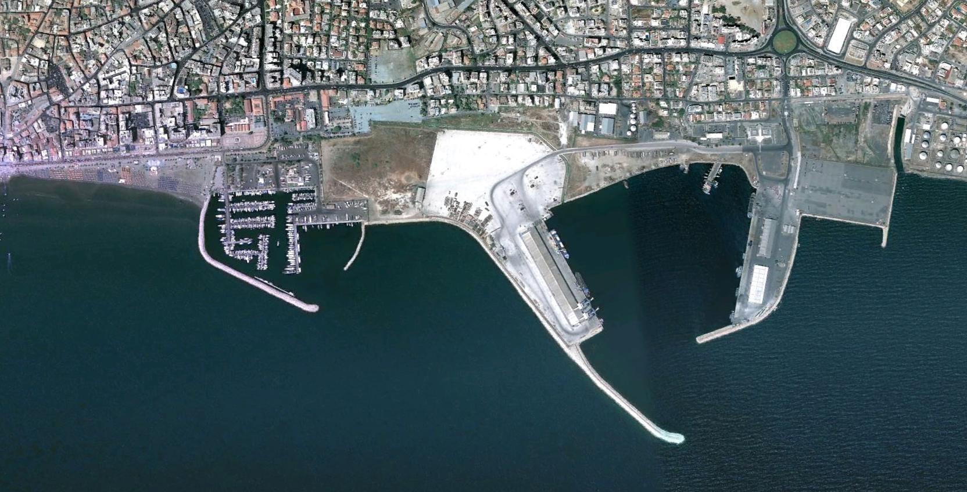
the waterfront

Slide 16
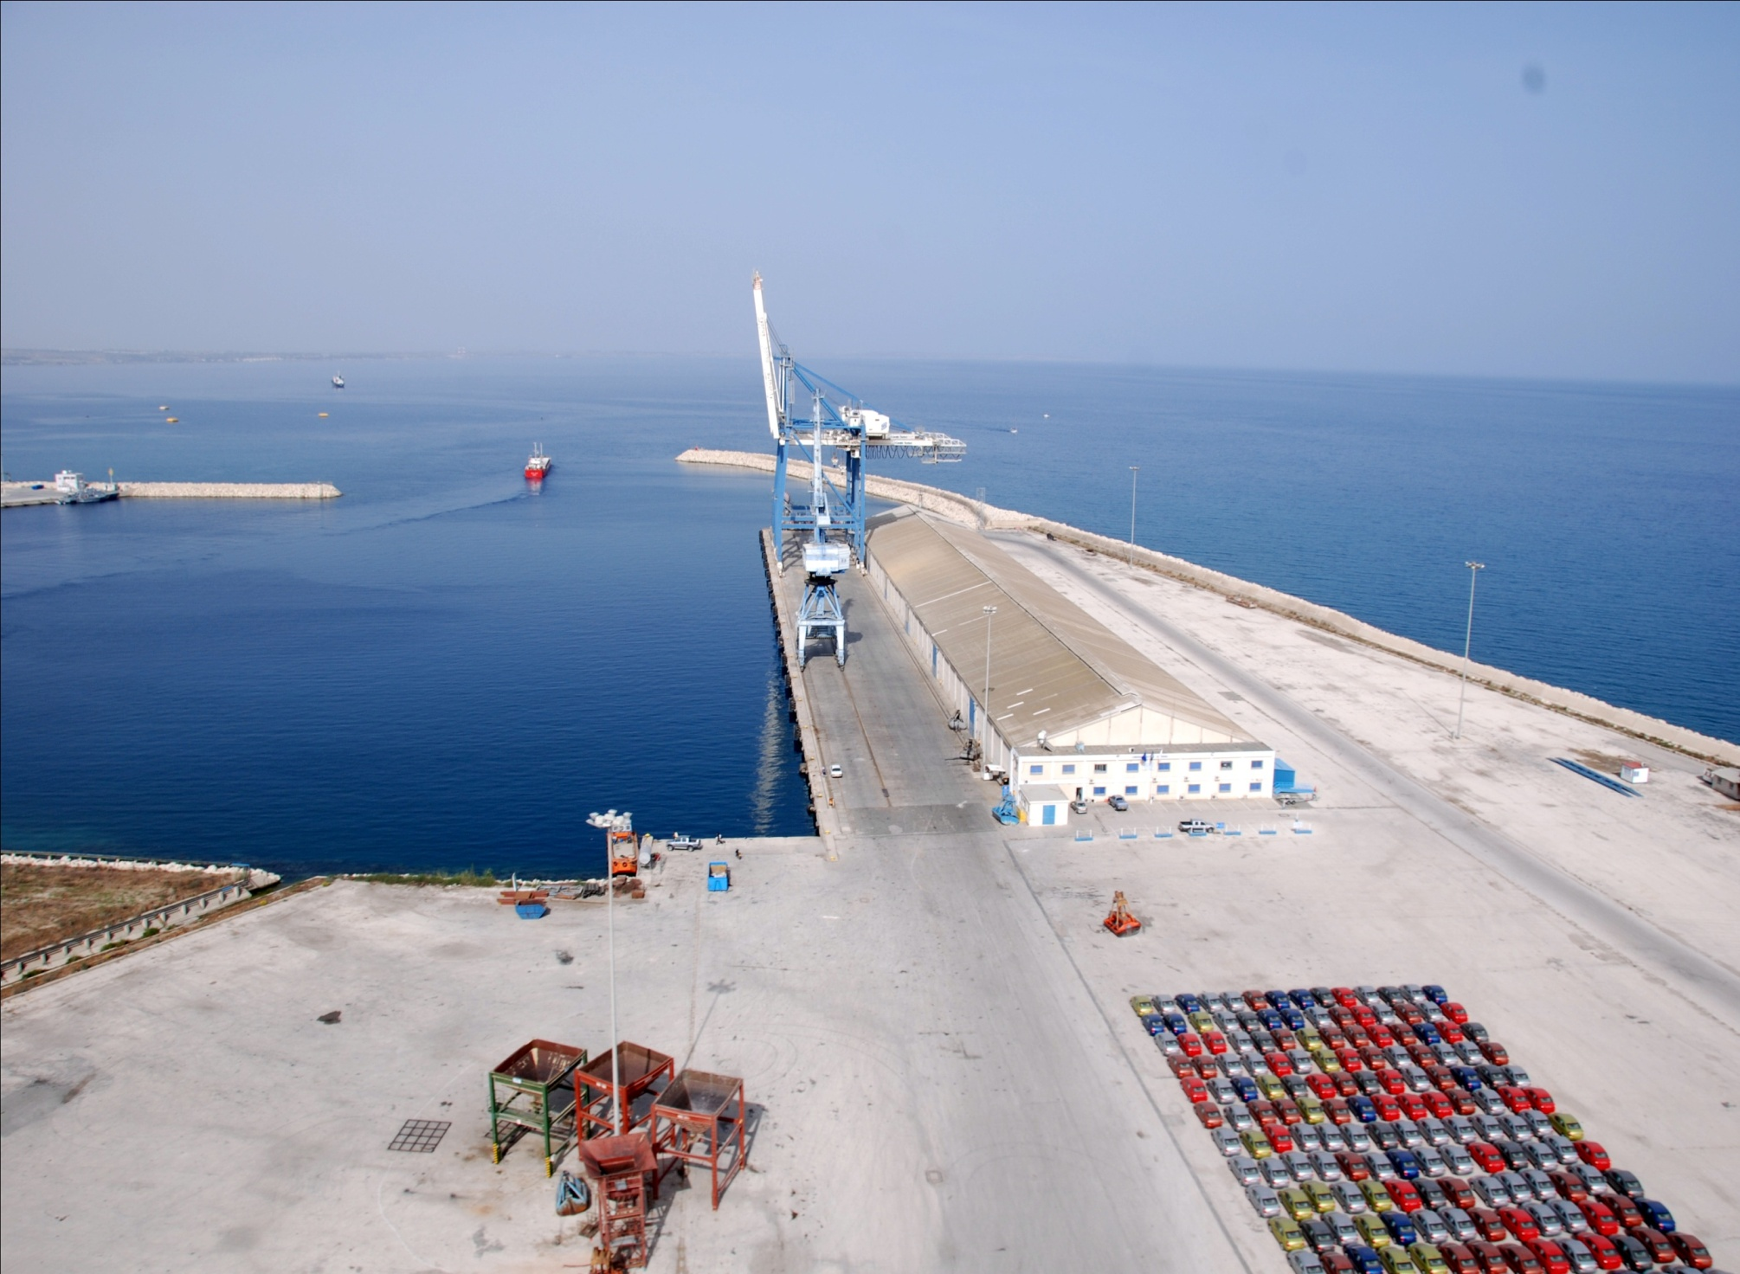
the waterfront

Slide 17
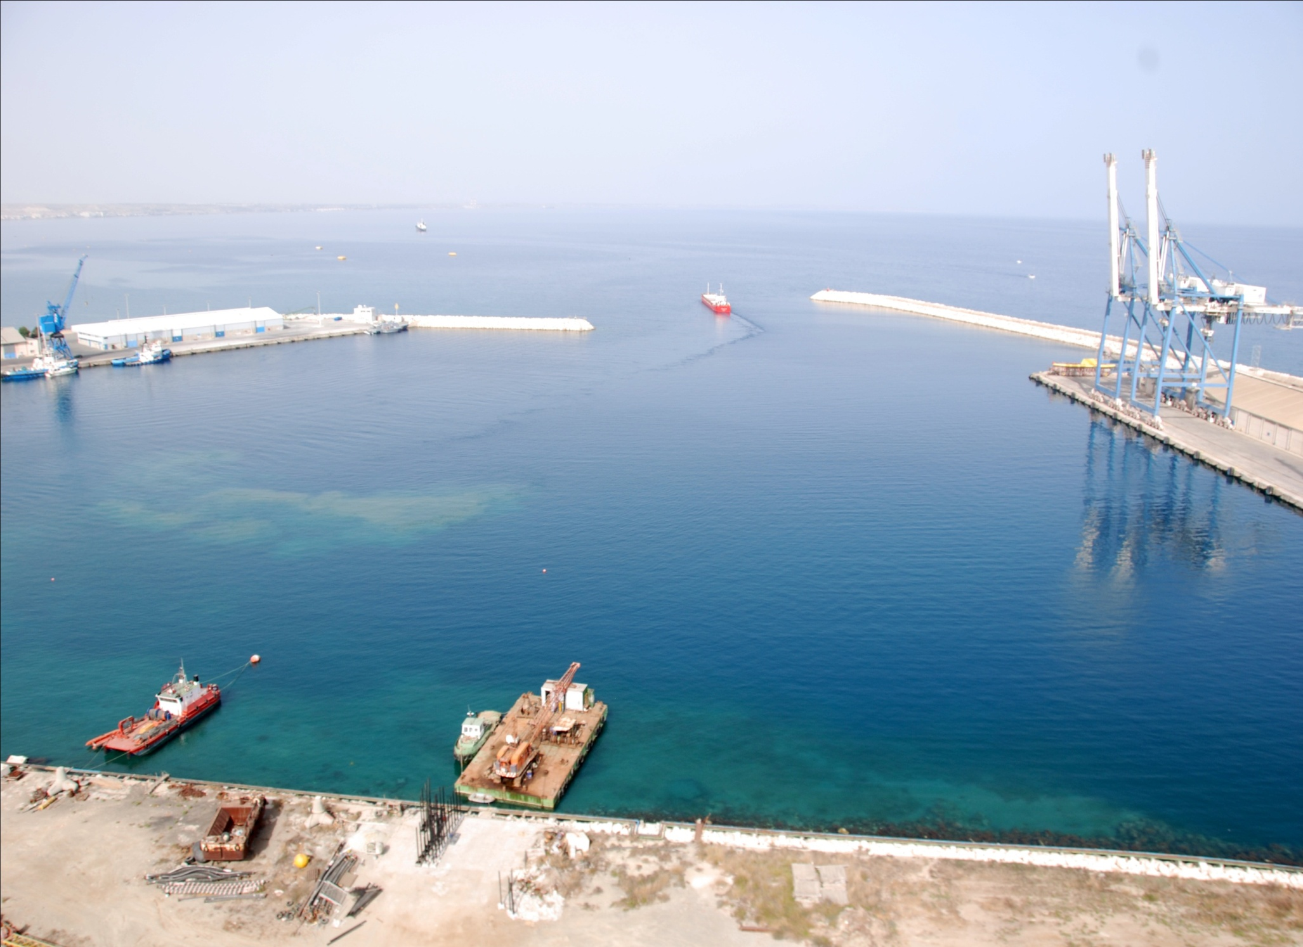
the waterfront

Slide 18
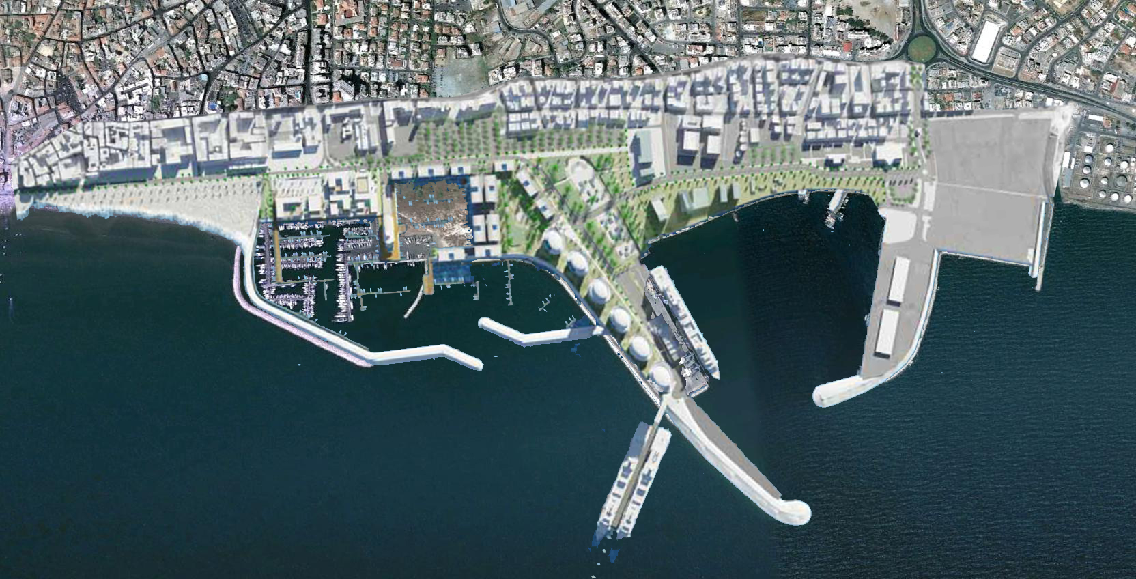
the waterfront

Slide 19
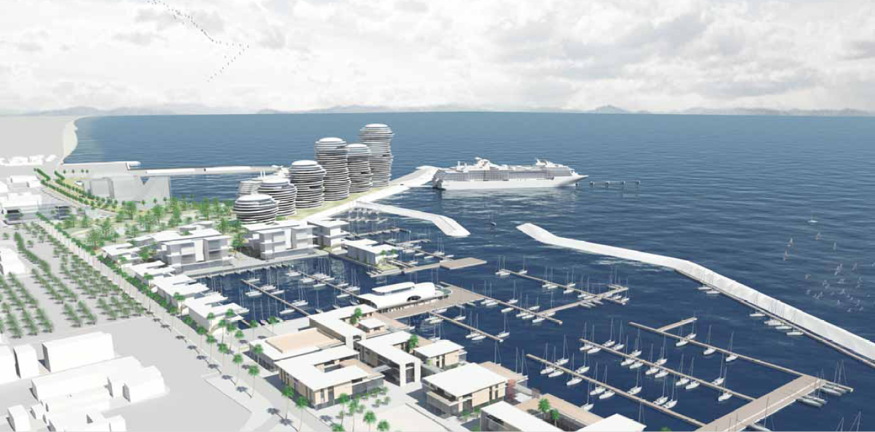
the waterfront

Slide 20
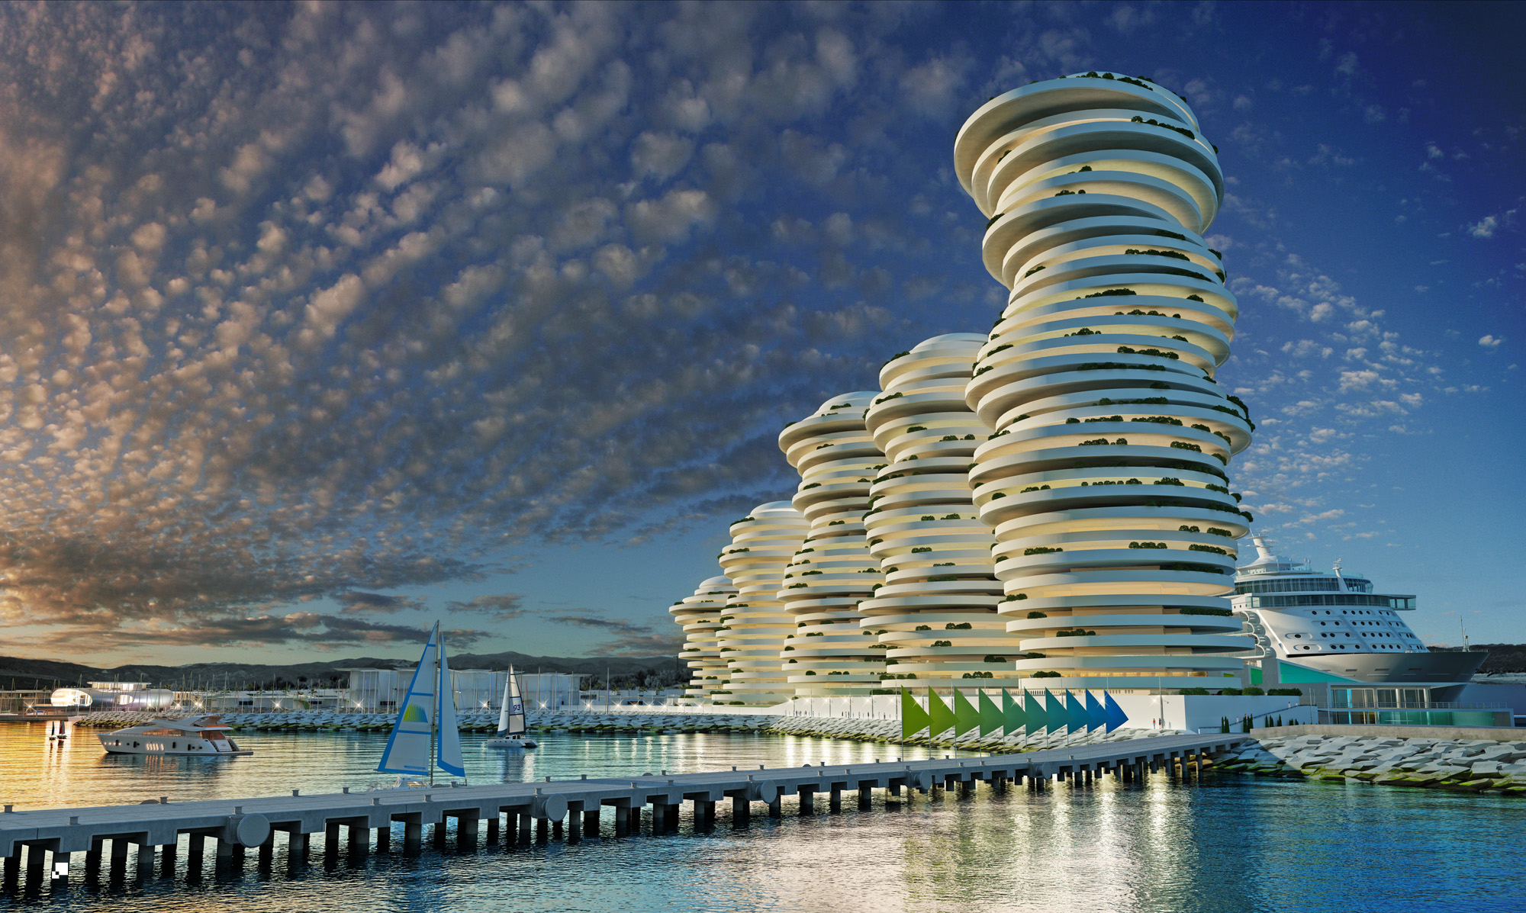

the waterfront

Slide 21
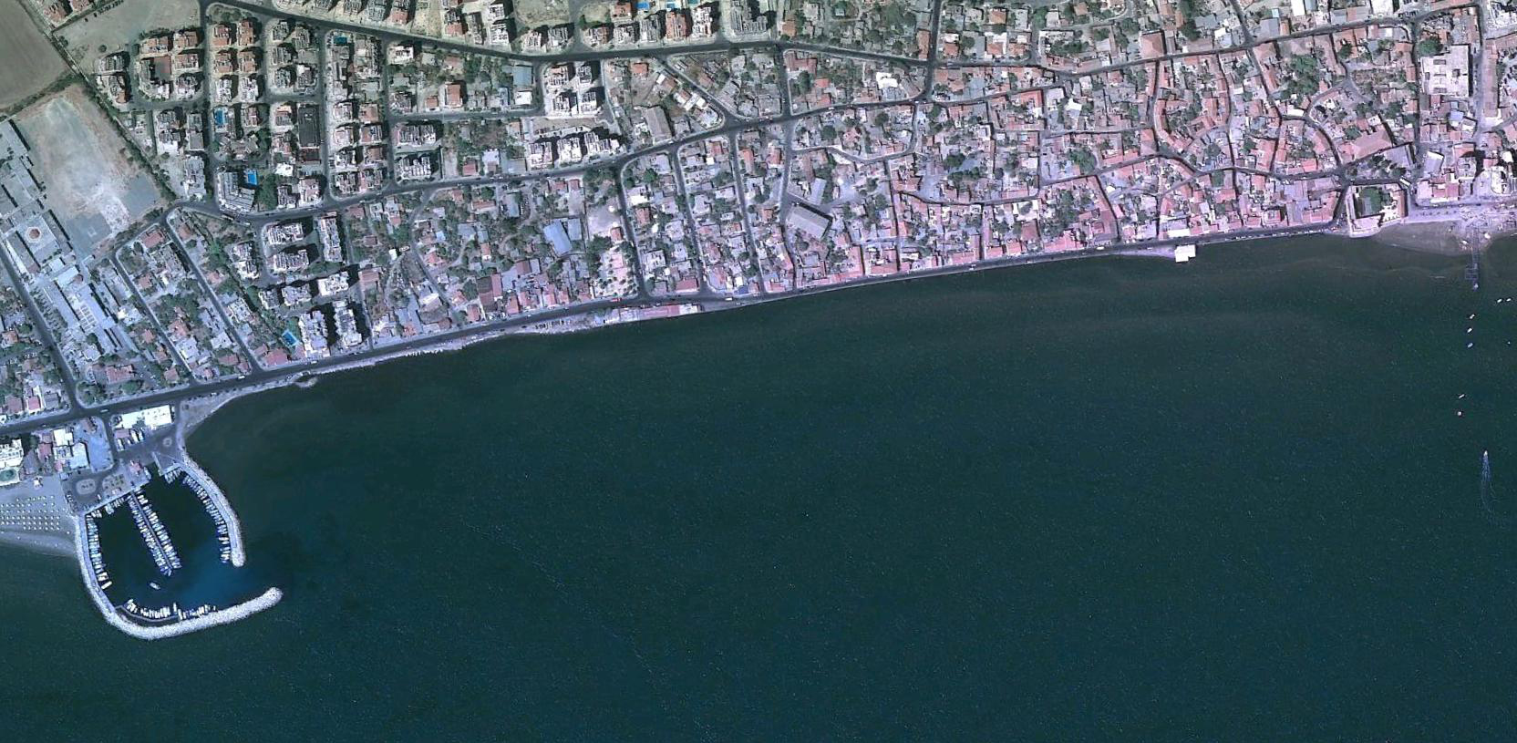
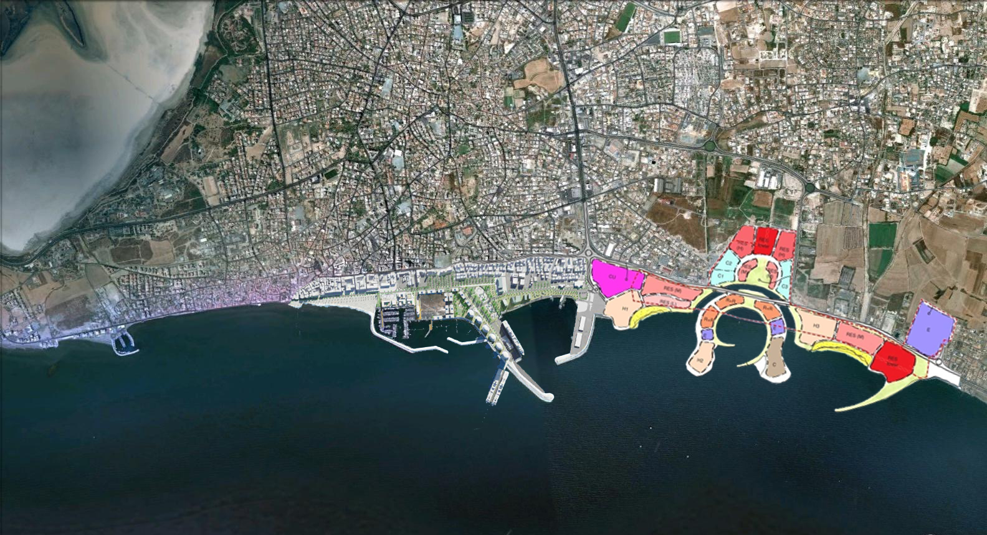
the promenade

Slide 22
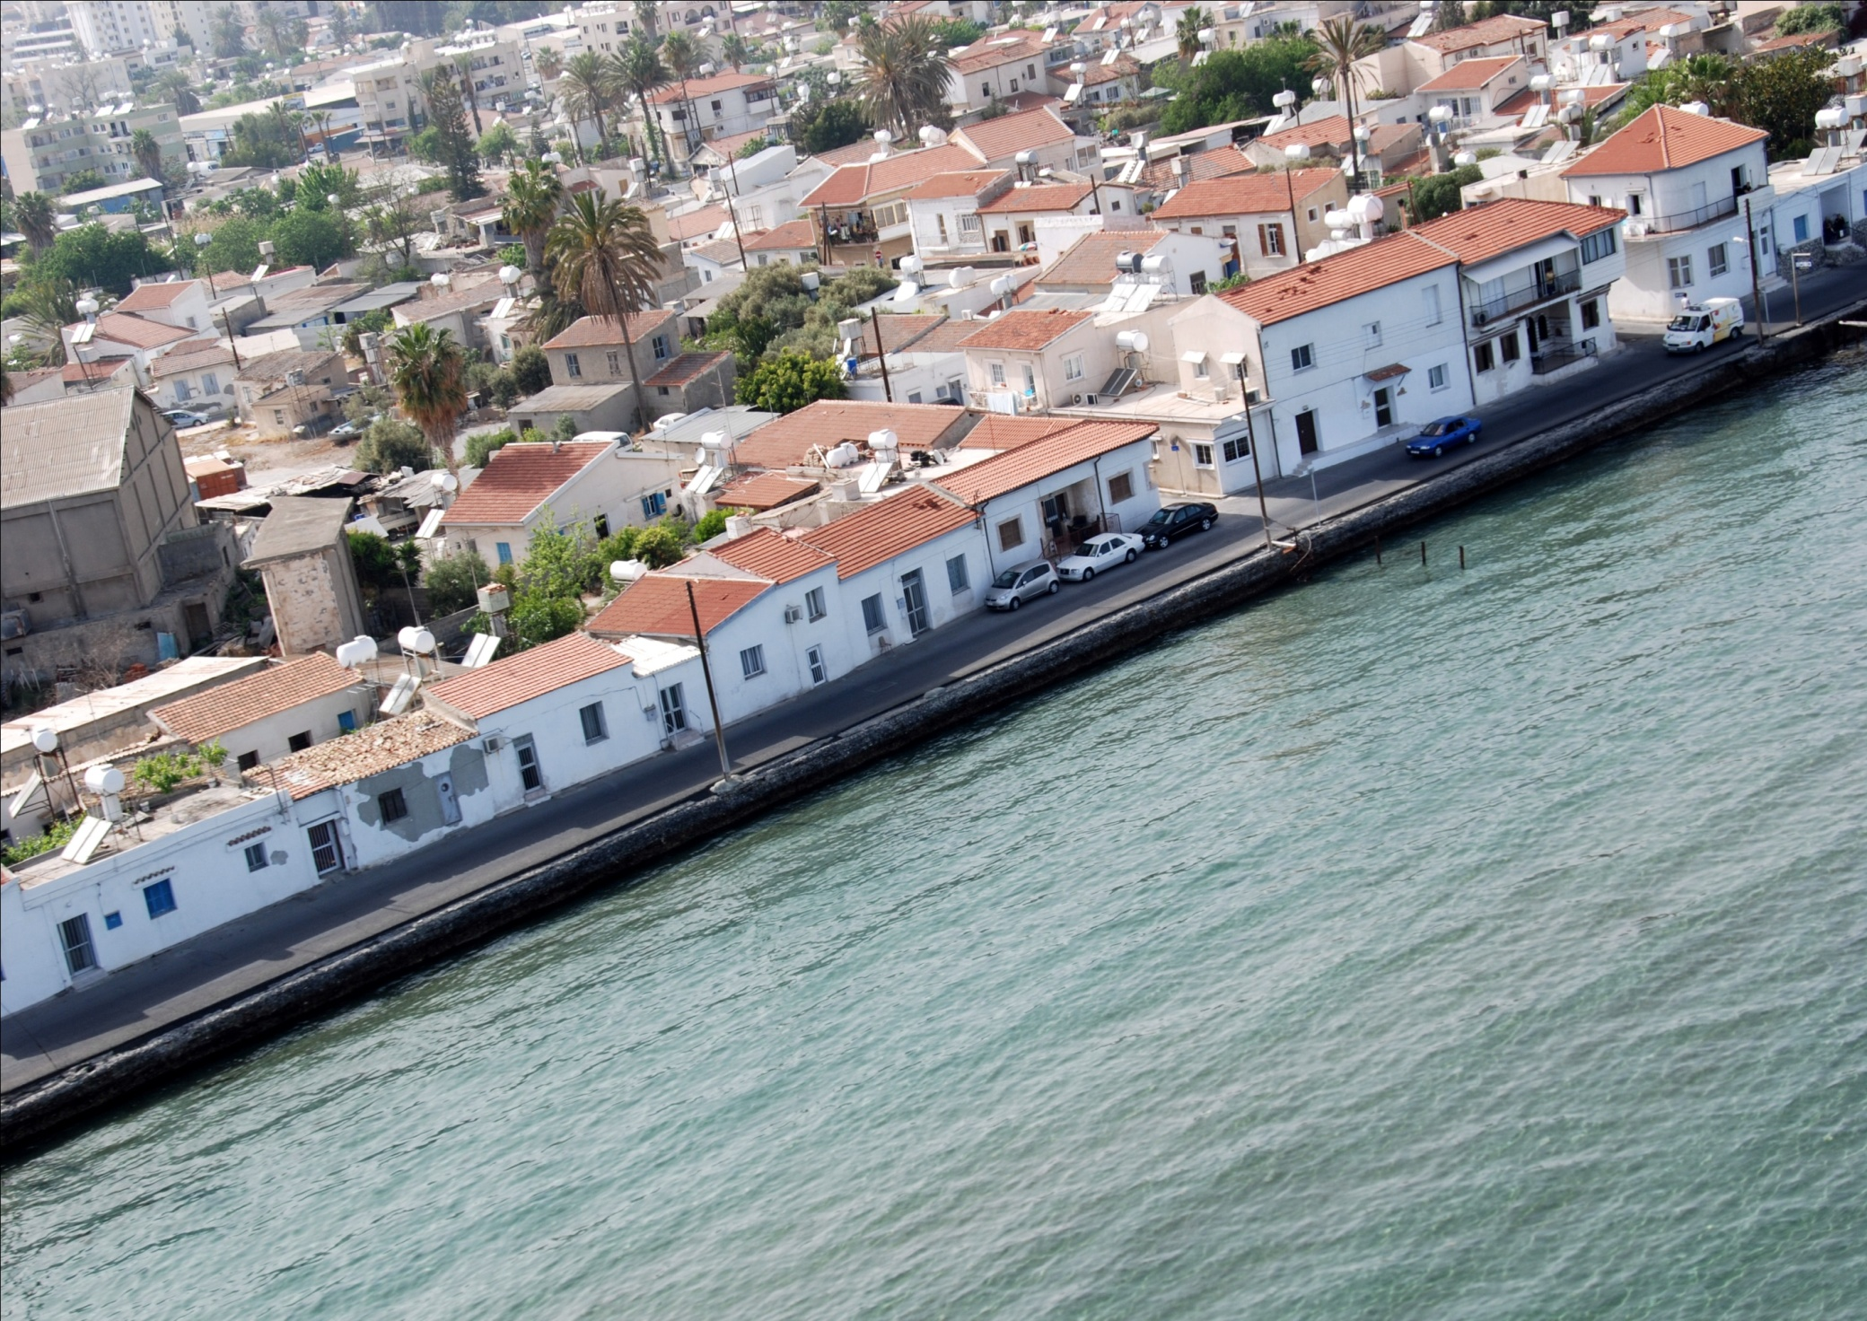
the promenade

Slide 23
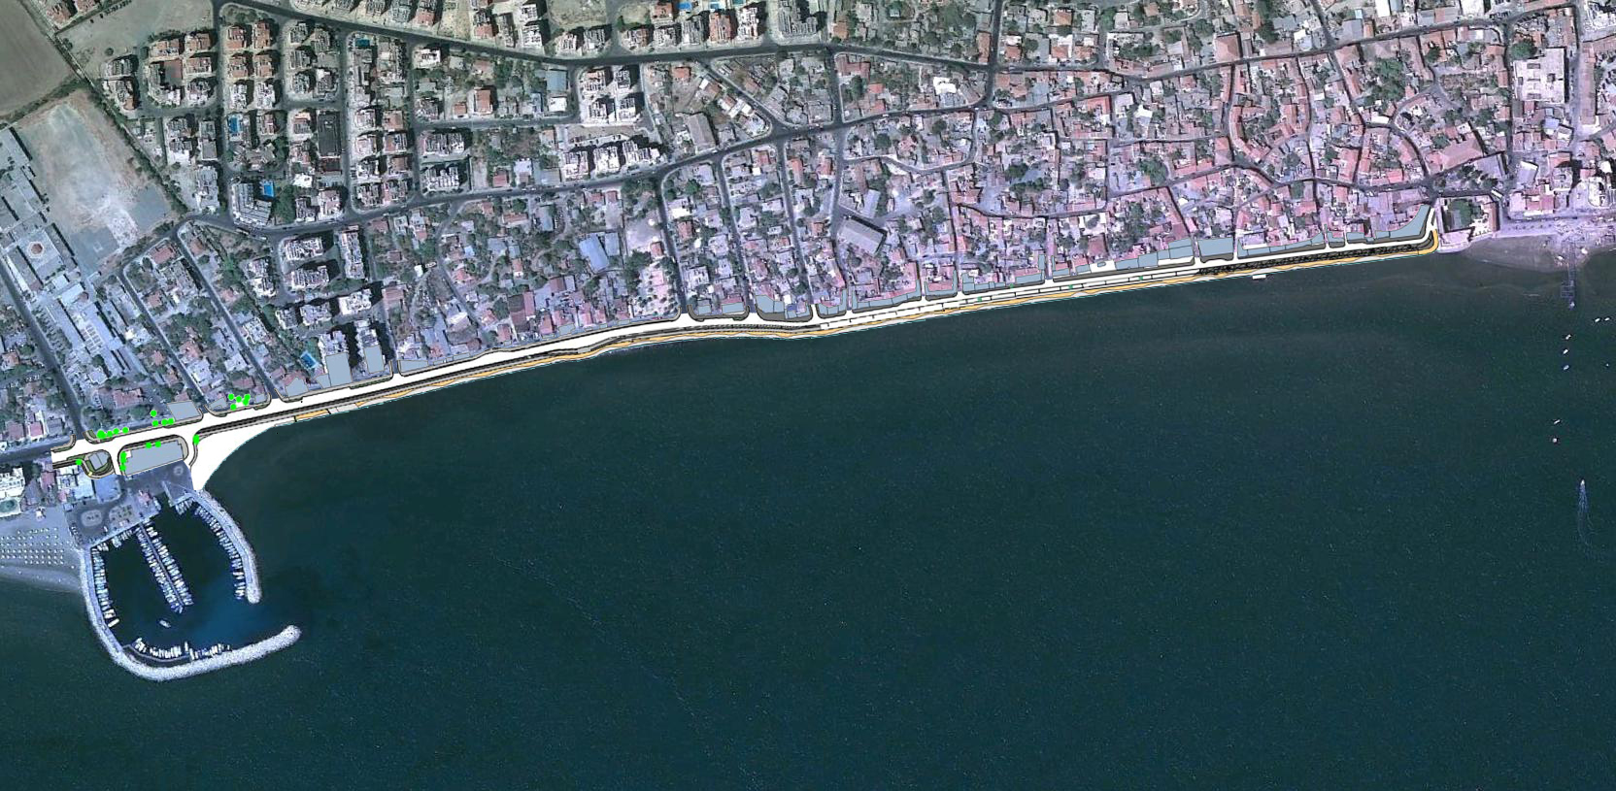
the promenade

Slide 24
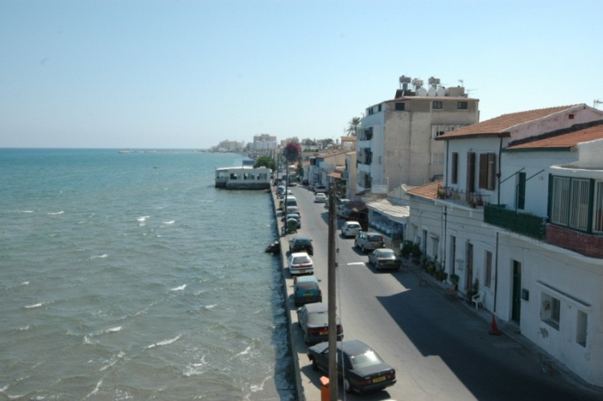
the promenade

Slide 25
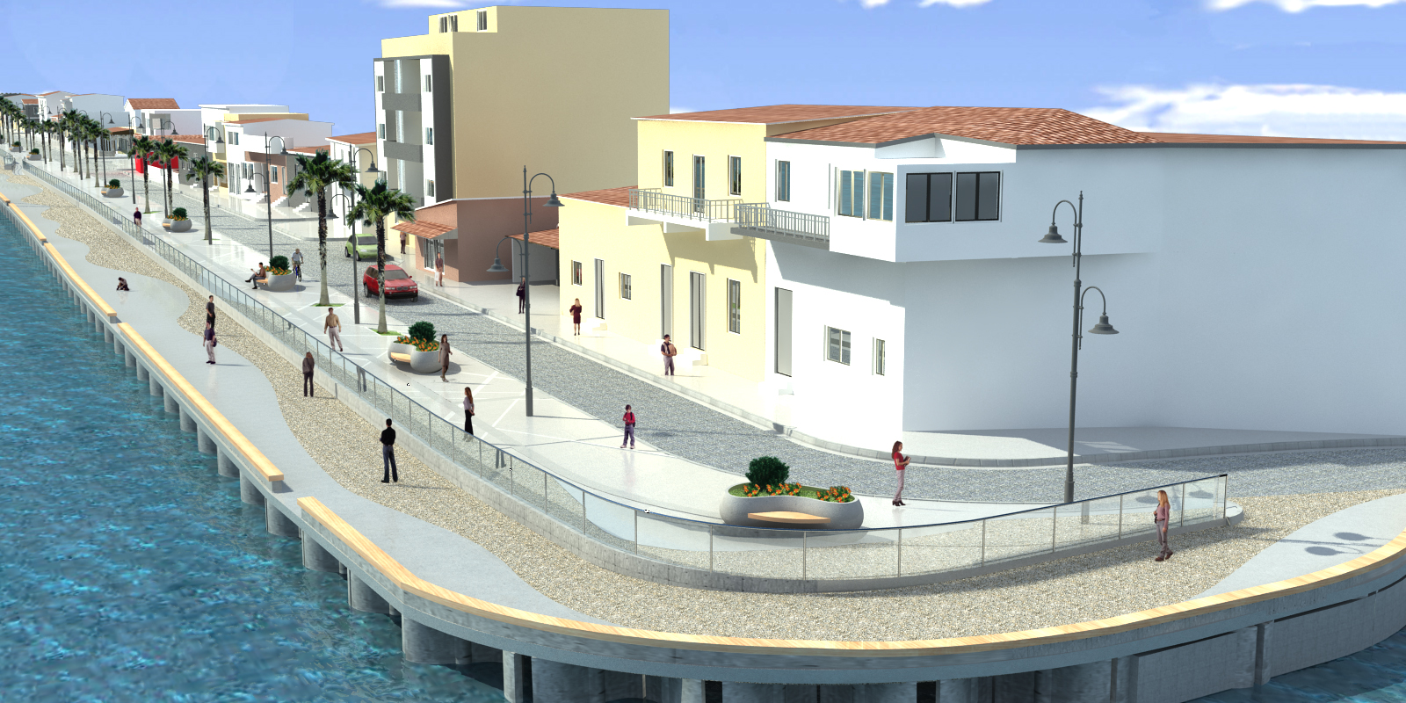
the promenade

Slide 26
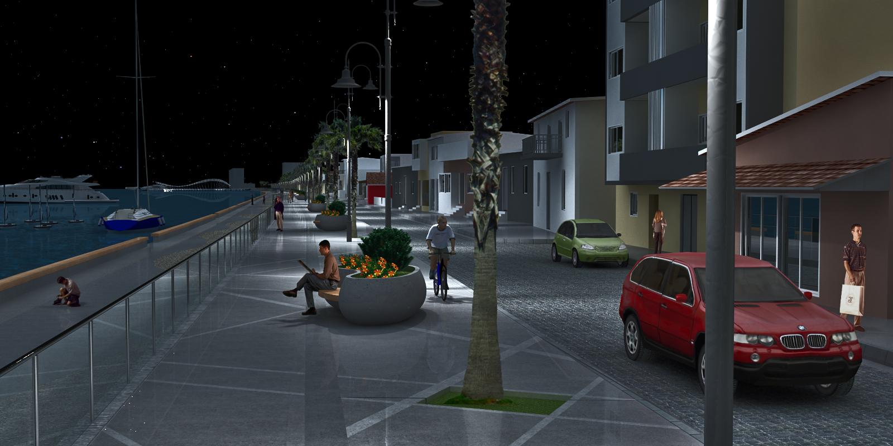
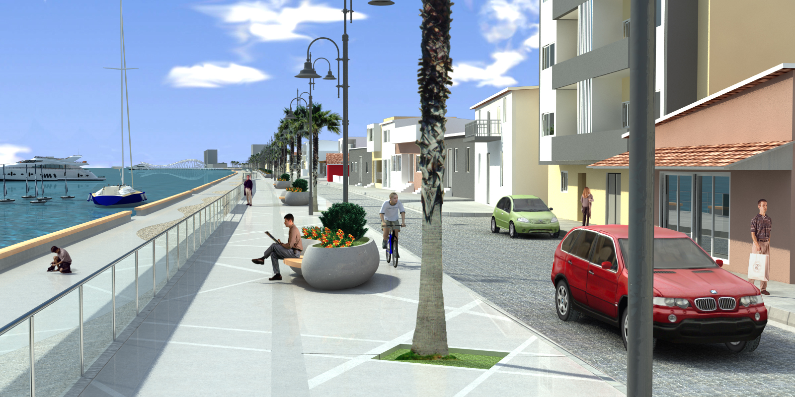
the promenade

Slide 27
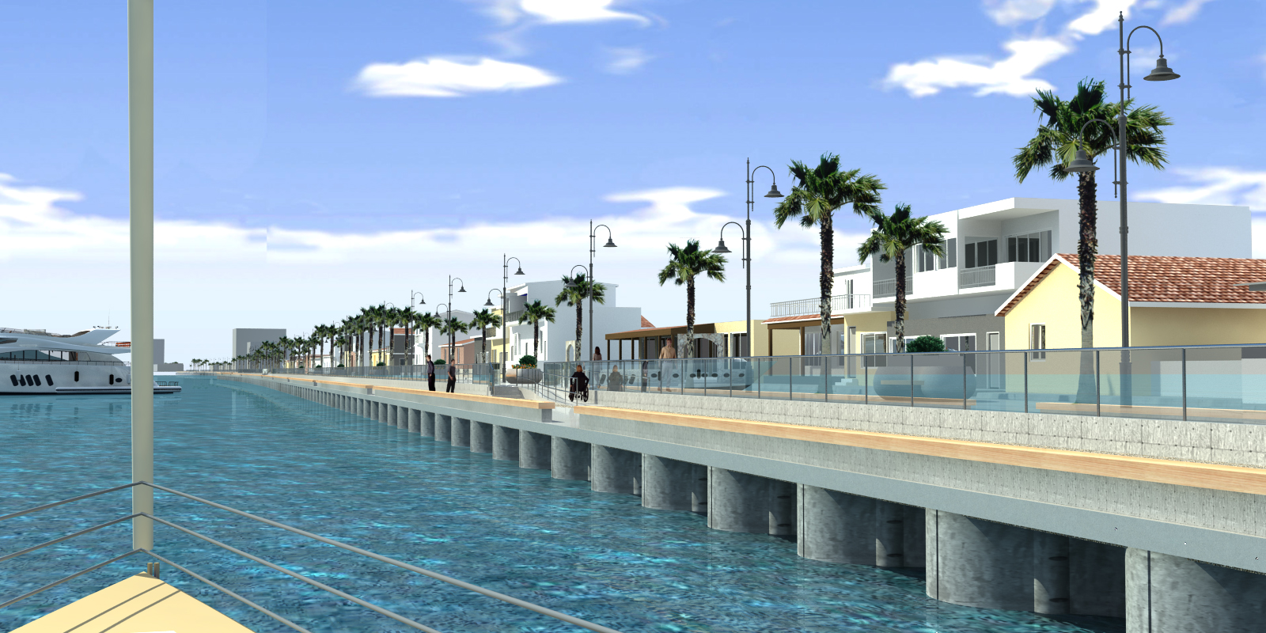
the promenade

Slide 28
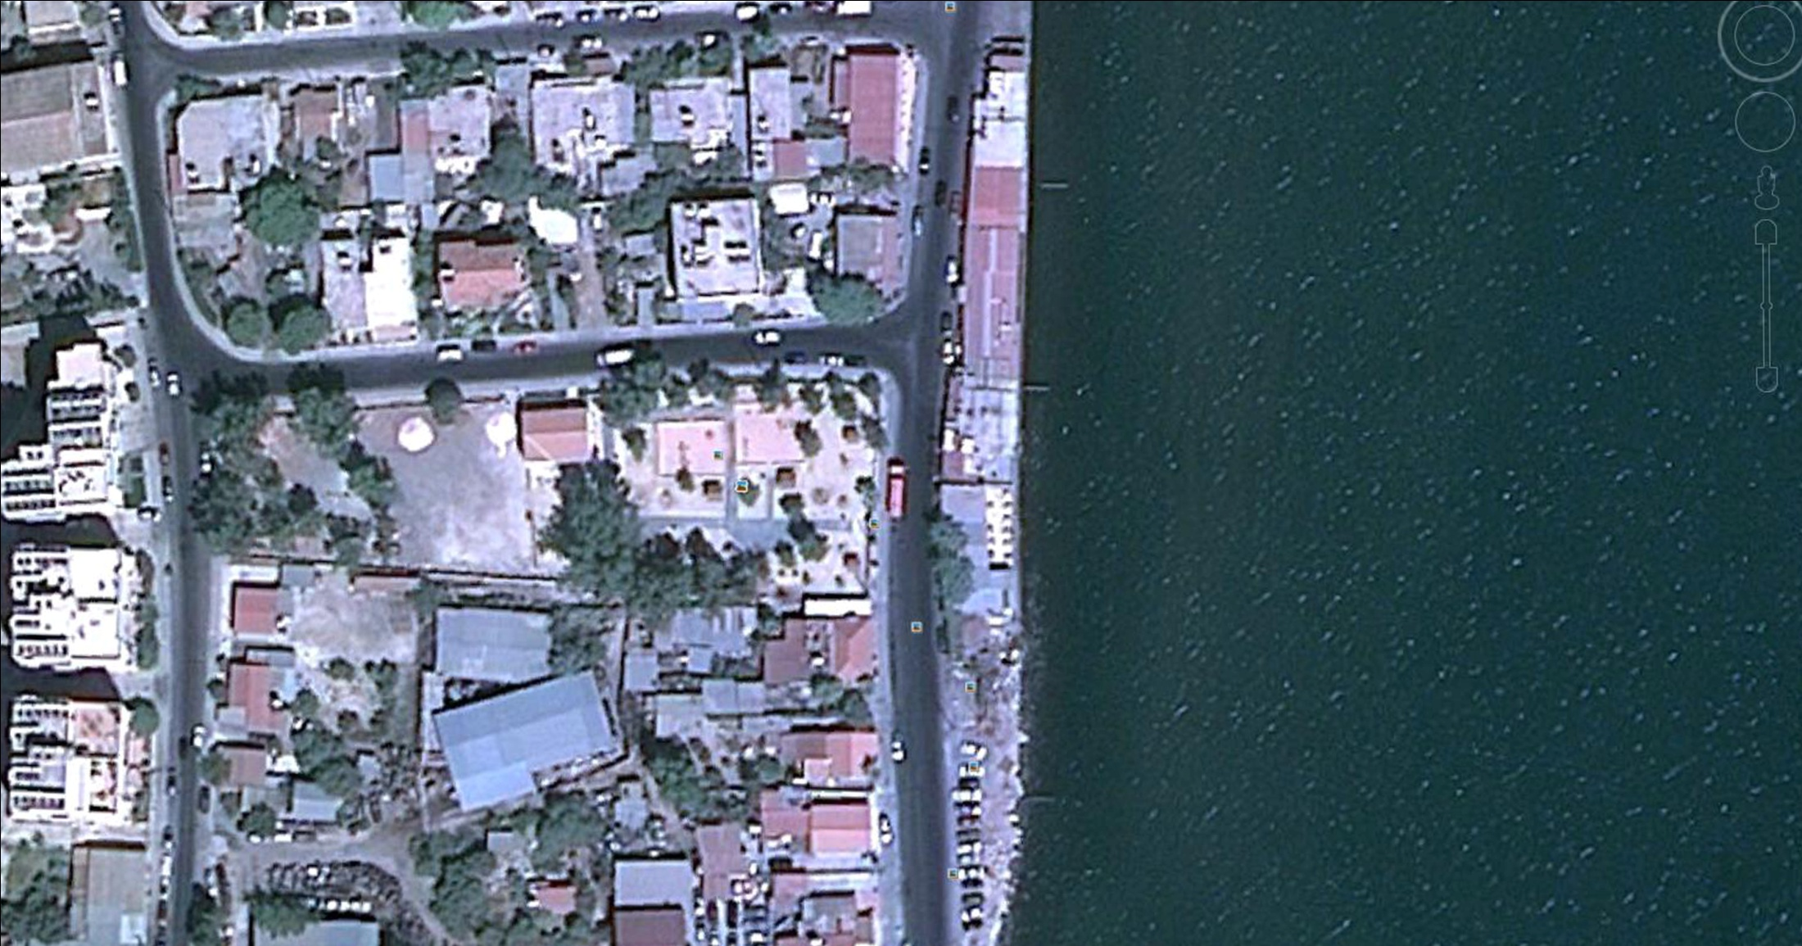

the pier

Slide 29
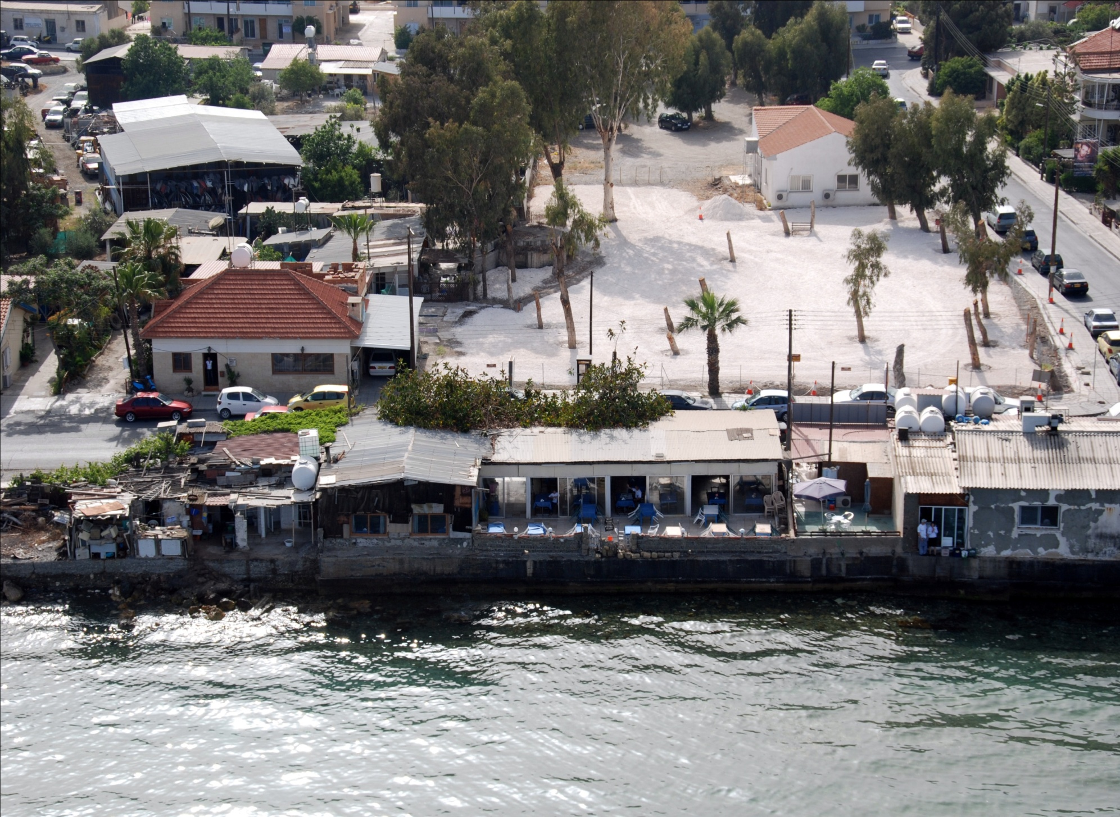
the pier

Slide 30
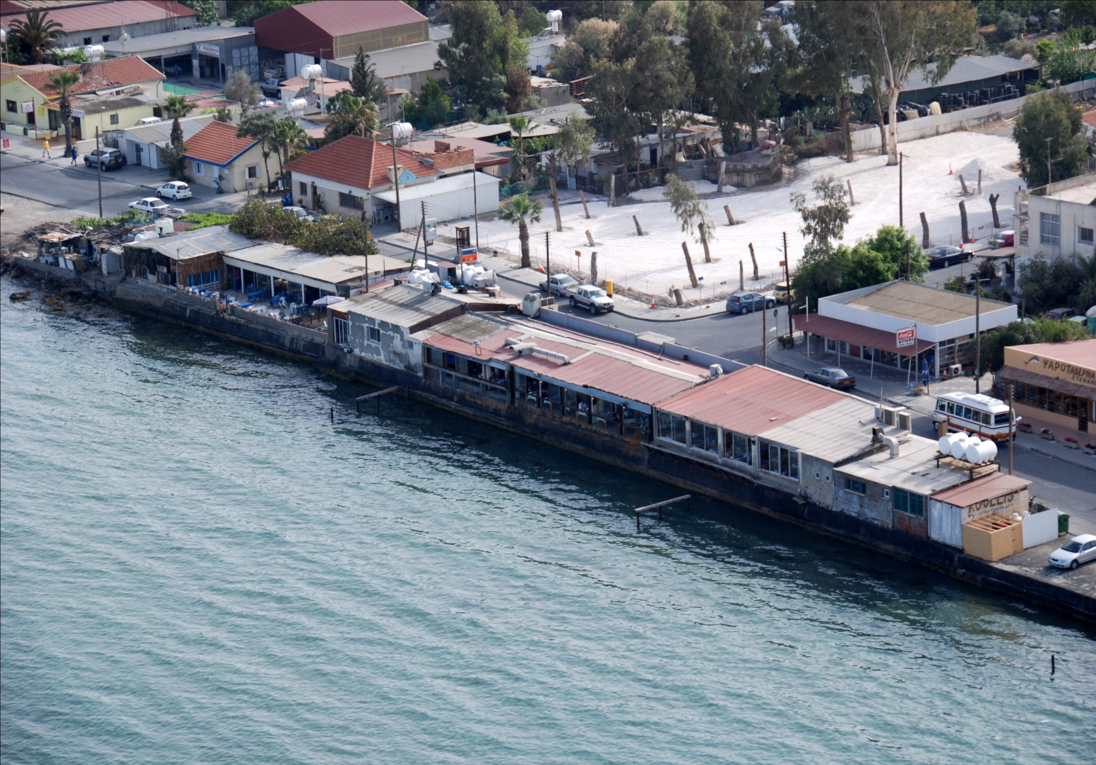
the pier

Slide 31
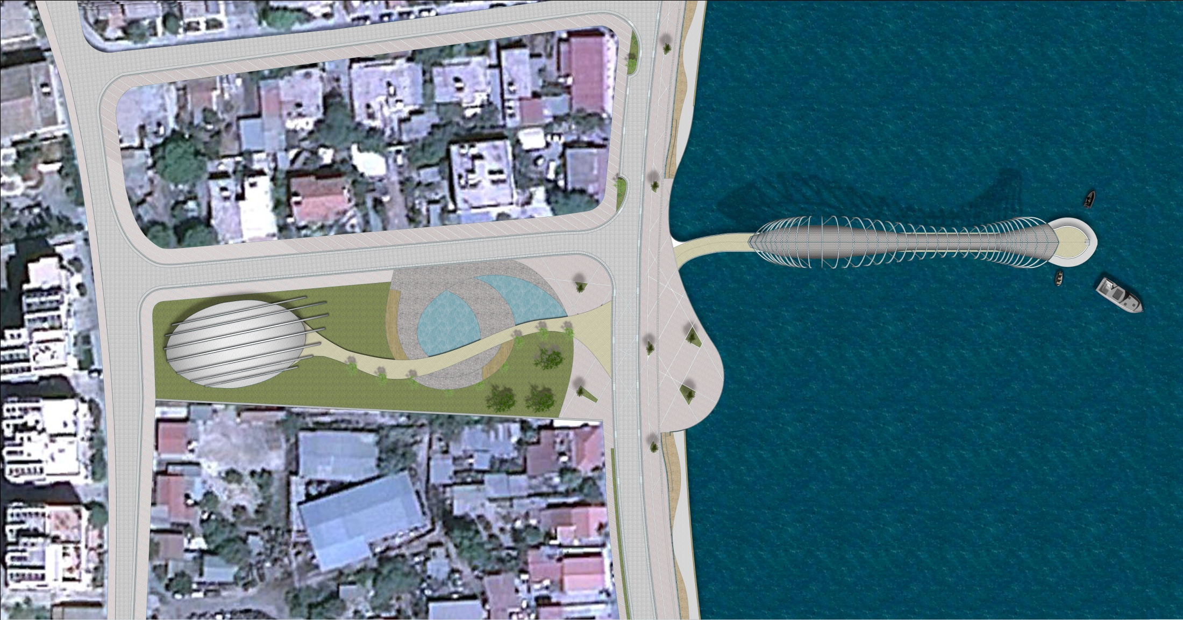
the pier

Slide 32
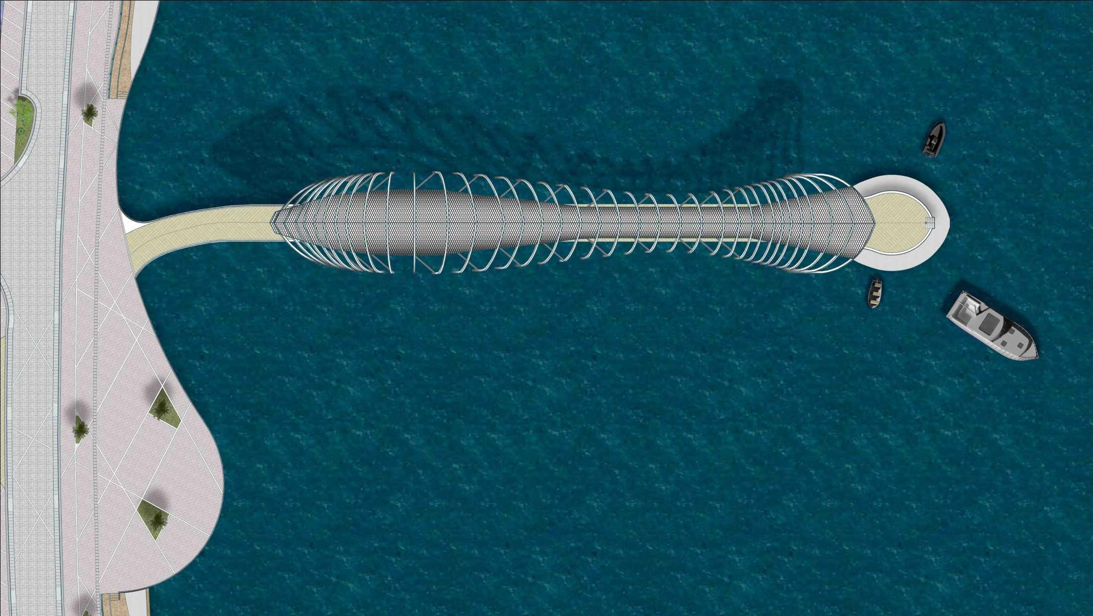
the pier

Slide 33
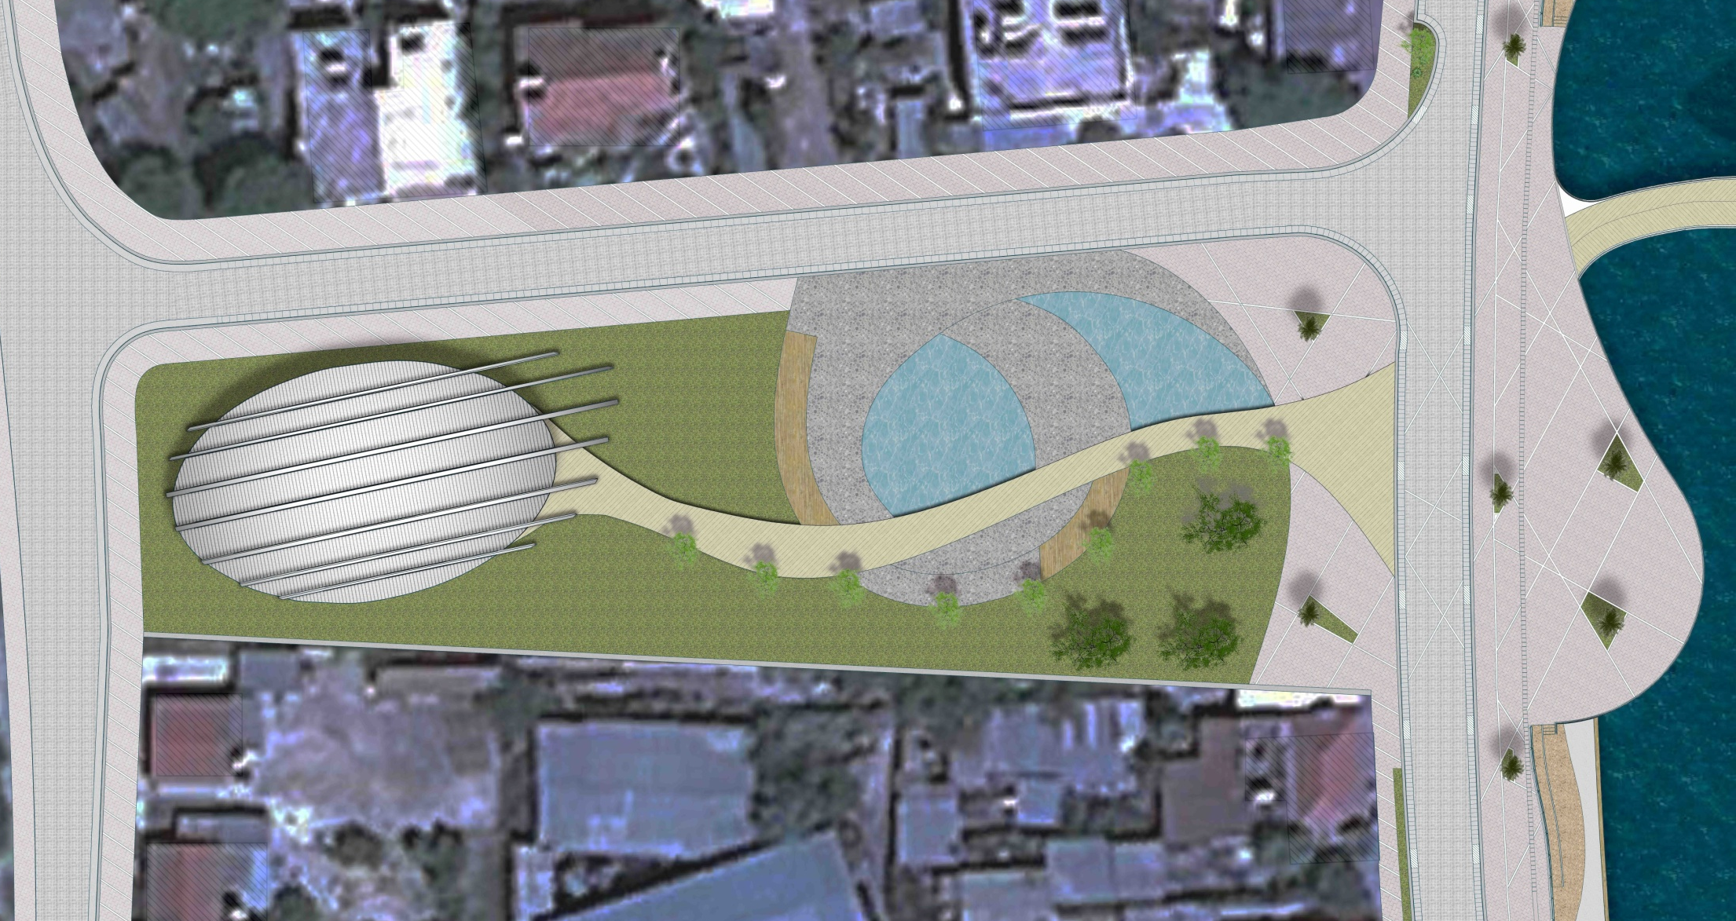
the pier

Slide 34
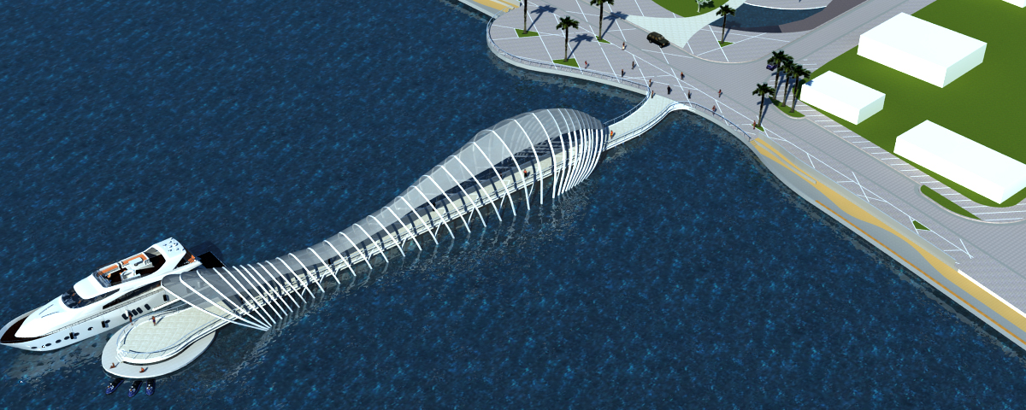
the pier

Slide 35
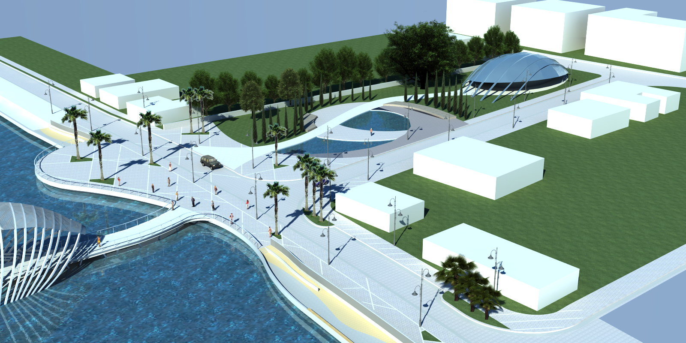
the pier

Slide 36
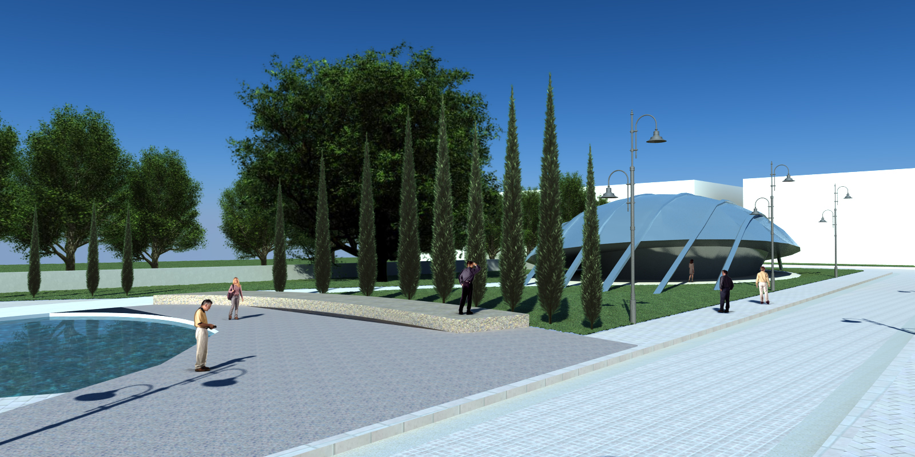
the pier

Slide 37
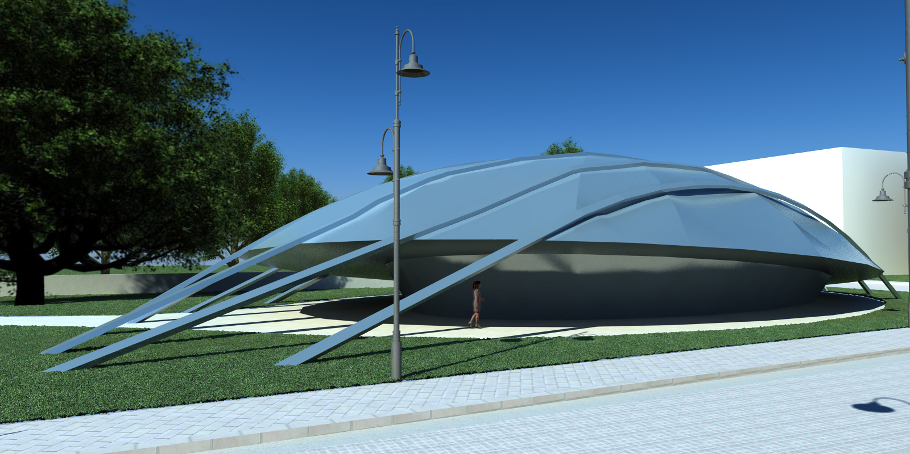
the pier

Slide 38
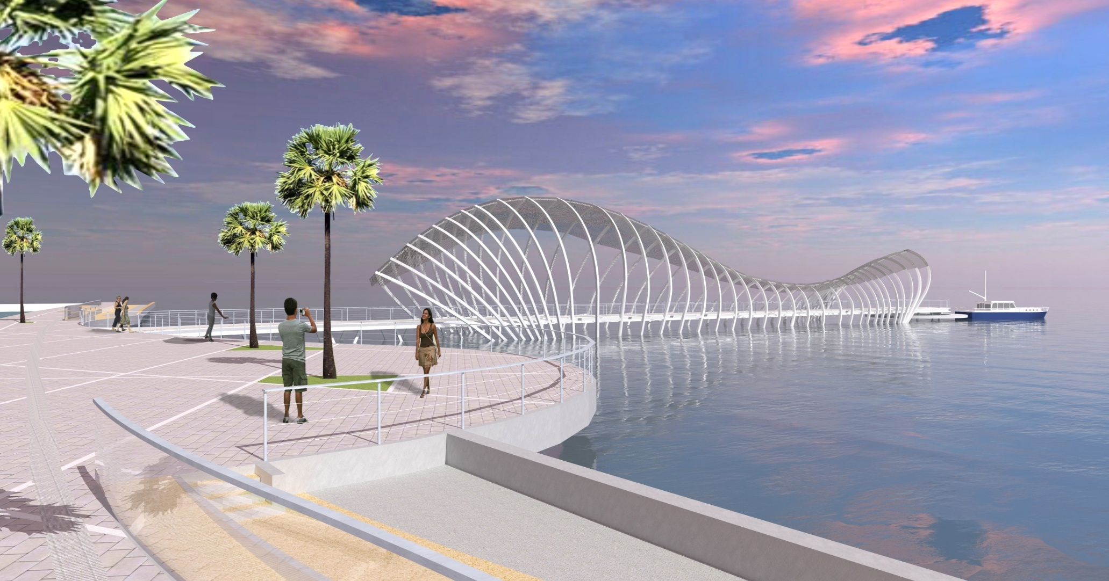
the pier

Slide 39
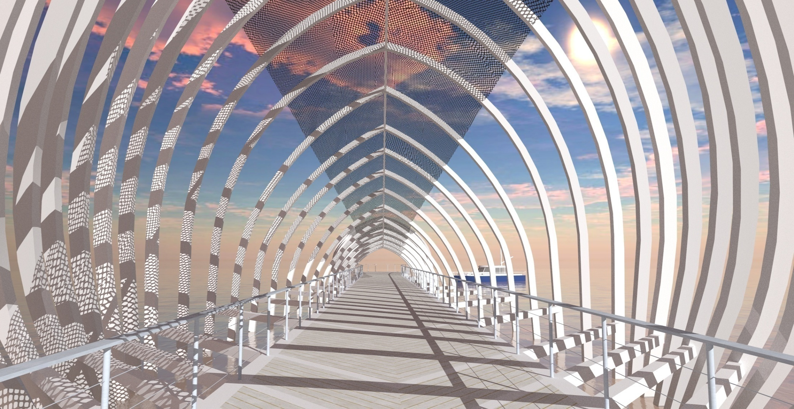
the pier

Slide 40
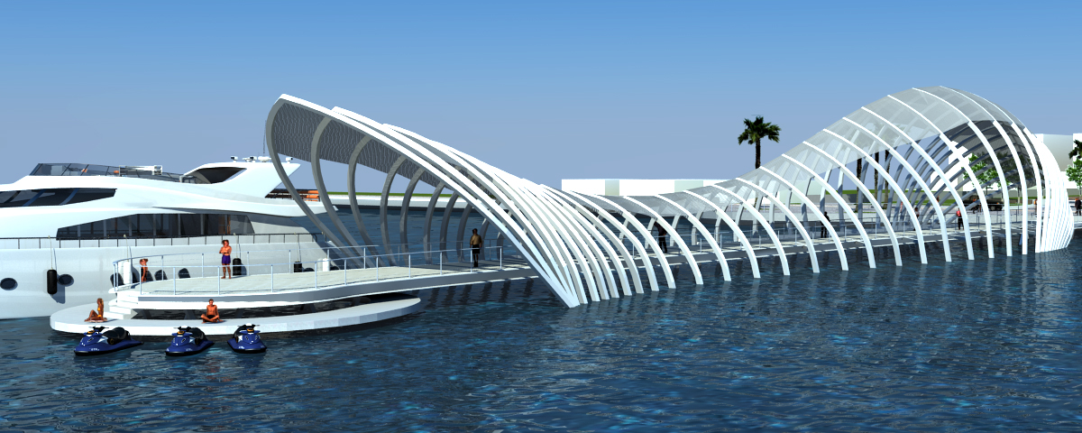
the pier

Slide 41
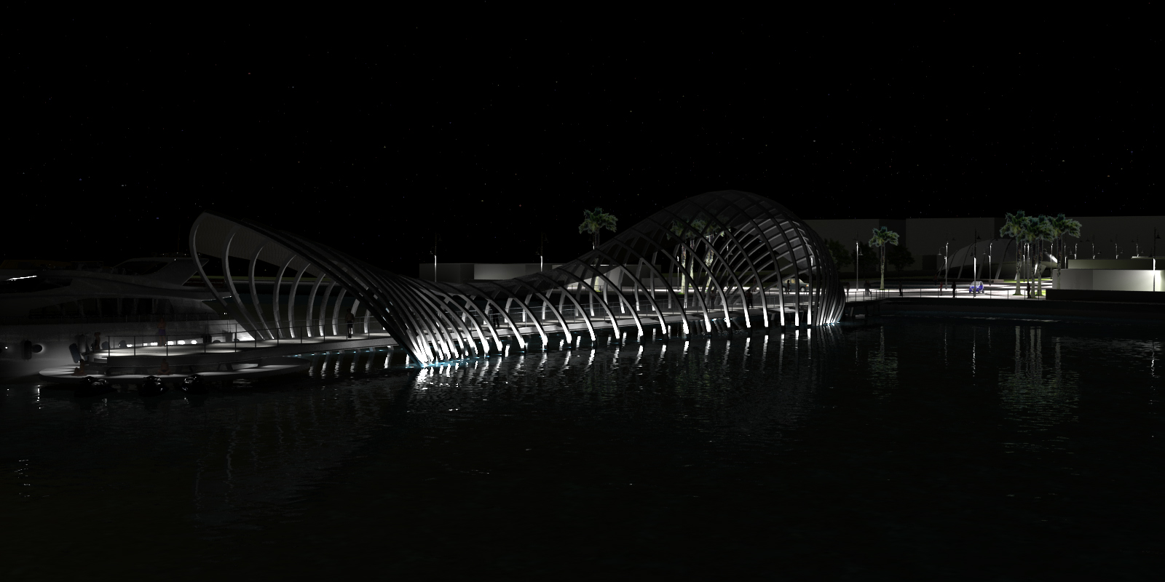
the pier

Slide 42
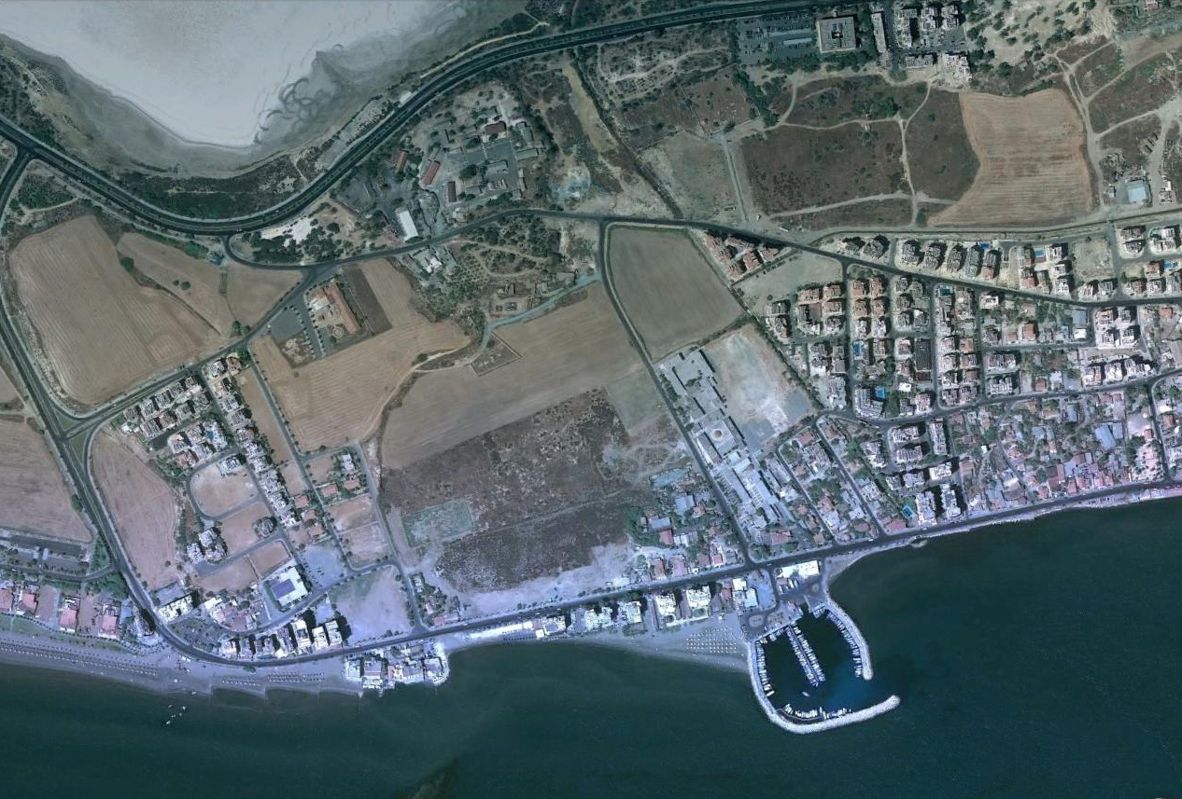

marina

Slide 43
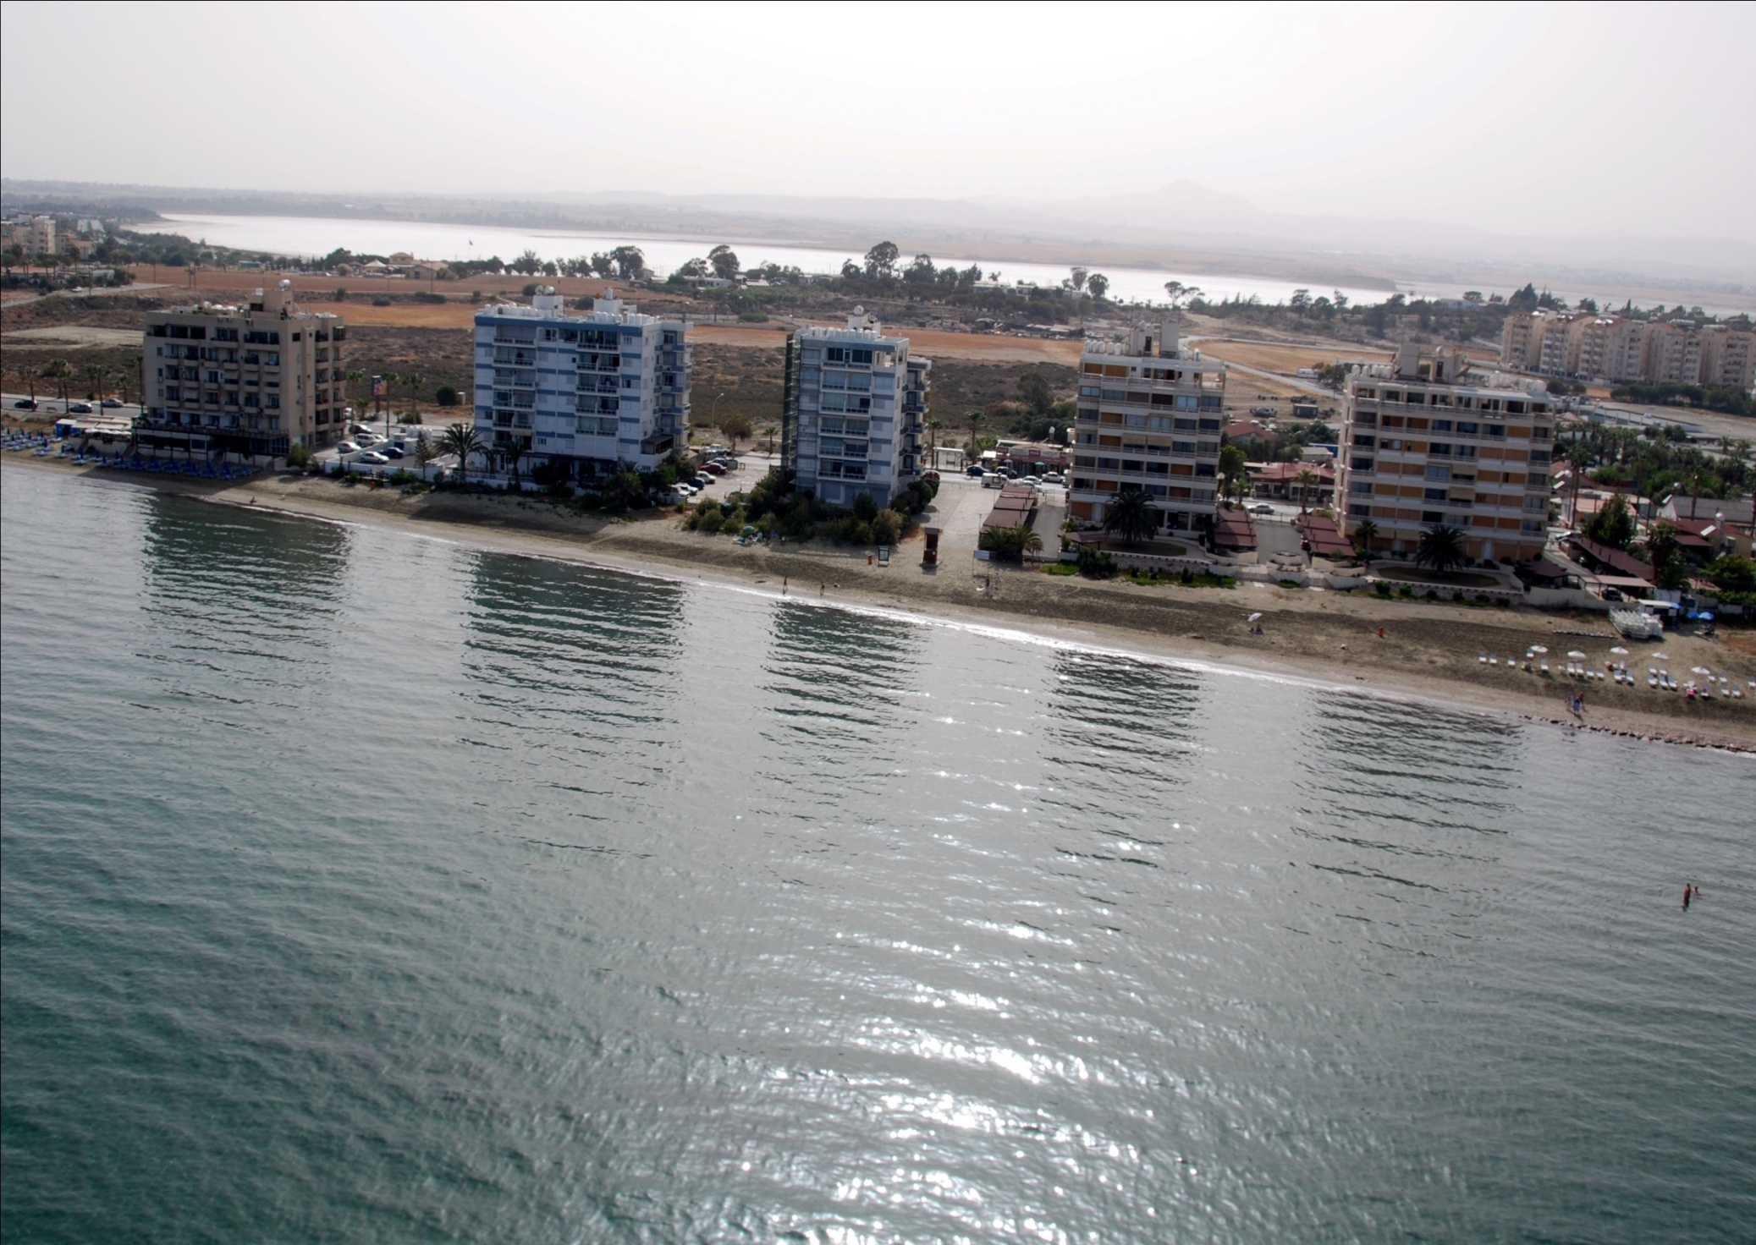
marina

Slide 44
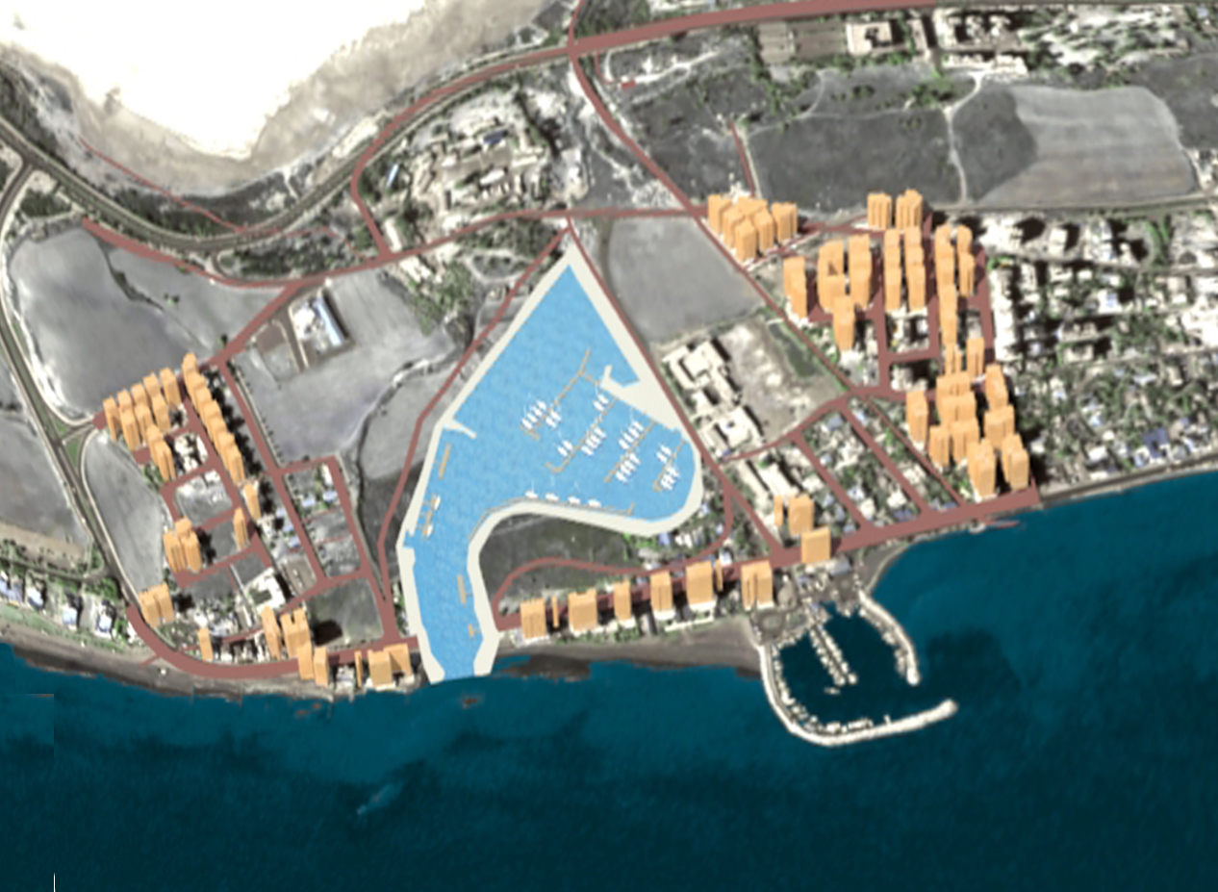
marina

Slide 45
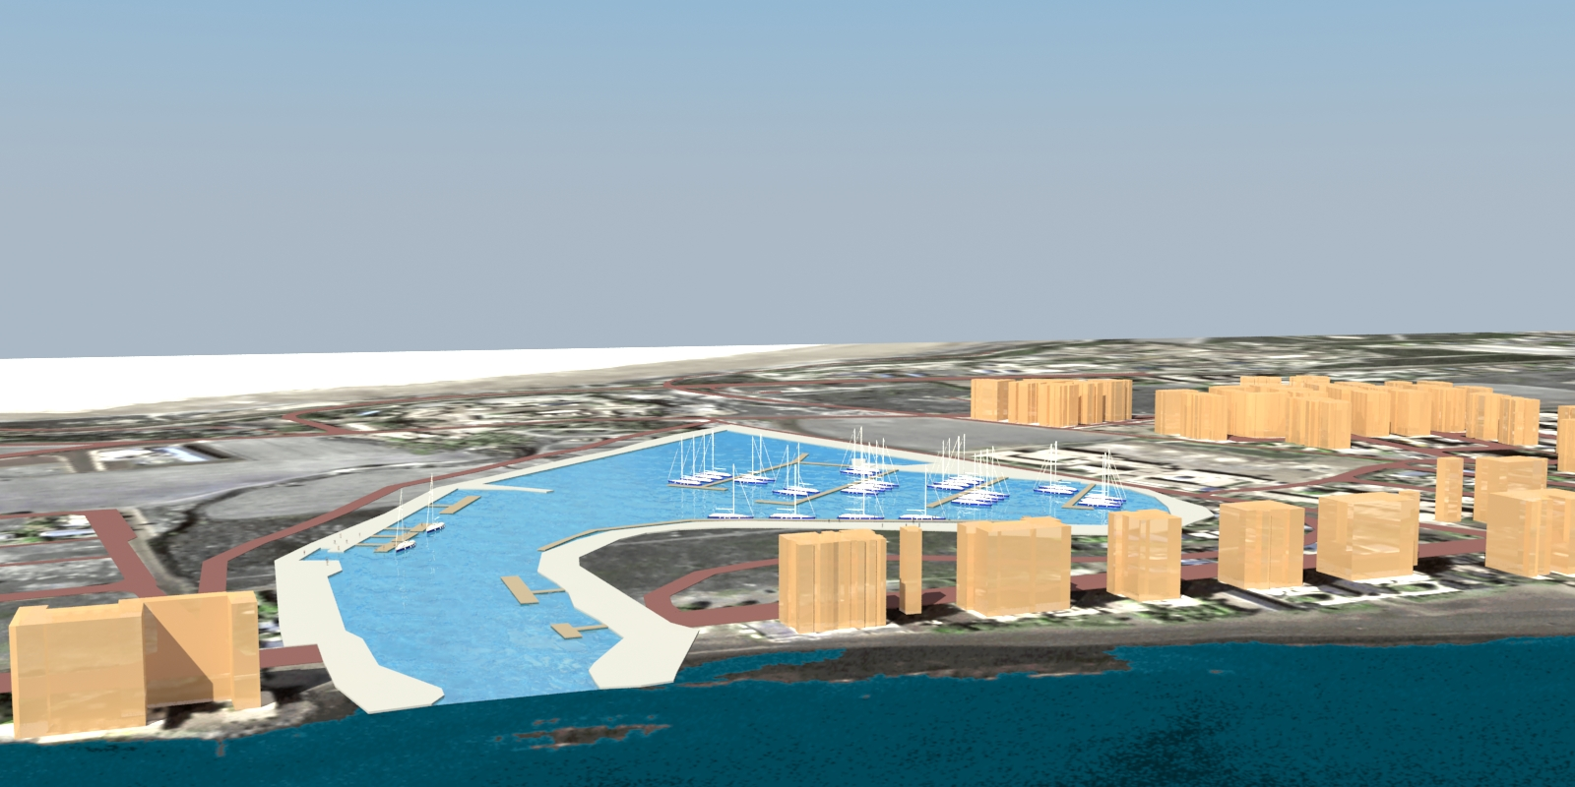
marina

Slide 46
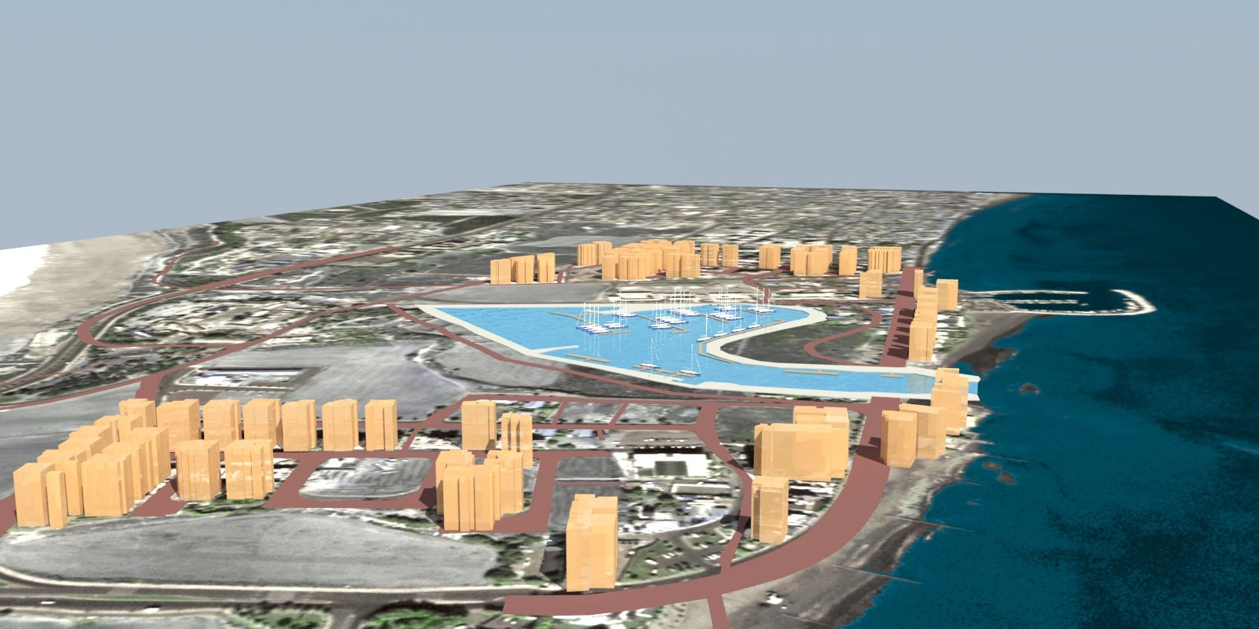
marina

Slide 47

marina

Slide 48

marina

Slide 49

marina

Slide 50

marina

Slide 51

new coastal larnaca

Slide 52
Larnaca
Political
commitment
Mayor
Municipal Council
USUDS
Urban
Sustainable
Strategies
Municipal
Services
Vision for new Larnaca

Slide 53
USUDS
Introduction
CREATED BY USUDS TEAM, 19/11/2013
USUDS Project – Awarded to Larnaca Municipality on 21 October 2011
Original Duration of Project 24 months
  [21 October 2011 – 21 October 2013]
Extension granted after official request by Larnaca Municipality
New Project completion date on 21 April 2014

Slide 54

USUDS organizational structure
CREATED BY USUDS TEAM, 19/11/2013
Organizational Structure

Slide 55
USUDS larnaca team
CREATED BY USUDS TEAM, 19/11/2013
Made up of:
  The Municipal Service
  Five Local Team Experts (who have been employed particularly for the project)
  A Steering Committee made up from the Mayor of Larnaca, members and representatives of organized groups of the city and government departments
  An International Consultant

Slide 56

USUDS LARNACA organizational structure
CREATED BY USUDS TEAM, 19/11/2013
Organizational Structure

Slide 57

Status so Far schedule
CREATED BY USUDS TEAM, 19/11/2013
the pre-diagnostic phase involves the collection of all data and studies for the city,
the diagnostic phase during which the data collected are evaluated and the priorities and the development prospects are determined
the strategic designing phase, during which the general strategic plan will be prepared,
the implementation phase during which, plans and actions will be devised in order to implement the strategy.

Slide 58

Activities Carried out preparation and organisation
CREATED BY USUDS TEAM, 19/11/2013
Constitution of Decision Making and Management Bodies of Larnaca USUDS
Familiarization with the USUDS Project
Completed Tender Procedure for the employment of the Local Team. Award of Tenders in September 2012.

Slide 59

Activities Carried out pre-diagnostic phase
CREATED BY USUDS TEAM, 19/11/2013
Collection, assessment and analysis of Data and Studies on various fields
Recruitment of an International Consultant [November 2012]
Public Participation Workshops on various fields [December 2012]

Slide 60


WORKSHOPS pre-diagnosis phase in larnaca
CREATED BY USUDS TEAM, 19/11/2013
workshop 11.12.2012
training 12.12.2012
  The objective of the workshop was to exchange information and comments with the group members in order to update the Descriptive Memory and document and establish the key issues for the development of the city.
  The partners of the project from Metropolitan Area of Barcelona, Fundación CIEDES and Urban Community of Al Fayhaa presented: [1] USUDS methodology, instruments and policies [2] Social participation and cooperation, [3] Strategic planning process, results and lessons learned
  The International Expert, Mr. Josep Acebillo, gave his preliminary reactions with regards the presentations of the Larnaca Local Team.

Slide 61

Activities Carried out diagnostic phase
CREATED BY USUDS TEAM, 19/11/2013
Preparation, organization and presentation of Workshops between February 2013 – April 2013:
  The Demographic Characteristics of Larnaca
  Important Infrastructure of Larnaca
  Environmental Wealth and Environmental Factors of Larnaca
  Socio-Economic Data of Larnaca/Shift and Share Analysis
  Urban Design and Urban Planning Parameters of Larnaca
  Preparation and publication of the Diagnostic Report

Slide 62


WORKSHOPS
Diagnostic phase
CREATED BY USUDS TEAM, 19/11/2013
workshop on demographics, 13.02.2013
  The USUDS Larnaca team provided studies and information collected from authoritative sources and comparative data at local and national level, regarding the demographic character of Larnaca. Useful conclusions concerning the development rhythms and prospects of Larnaca were extracted through the workshop.

Slide 63


WORKSHOPS
Diagnostic phase
CREATED BY USUDS TEAM, 19/11/2013
workshop on infrastructure, 28.02.2013
  The infrastructure of Larnaca District was presented such as: the electric power grid, water supply, sewerage and storm water sewage system, the petroleum storage terminals, the proposed energy center, the airport and the port of Larnaca, transfers etc.
  The Mayor of Larnaca, Mr. Andreas Louroutziatis, also attended the presentation and his involvement was supportive and valuable.

Slide 64


WORKSHOPS
Diagnostic phase
CREATED BY USUDS TEAM, 19/11/2013
workshop on environment, 12.03.2013
  The current environmental situation and the challenges facing Larnaca were examined.
  The citizen’s point of view and the society’s opinion had a significant impact throughout the whole process of developing USUDS’s workshops. The discussion included the environmental wealth and the need for proper management, for sustainability and green growth.

Slide 65


WORKSHOPS
Diagnostic phase
CREATED BY CONSTANTINA CONSTANTINIDOU, 19/11/2013
workshop on economy, 27.03.2013
  The workshop was made more relevant due to the fact that at the present period the economy of Cyprus is characterized by unique and unprecedented challenges.
  The government and its citizens have to face a number of issues, such as negative growth, high unemployment, problems in the banking sector and financial imbalances.

Slide 66


WORKSHOPS
Diagnostic phase
CREATED BY USUDS TEAM, 19/11/2013
workshop on planning, 08.04.2013
  The objective of the workshop was to assess the urban characteristics of Larnaca having as background the existing Local Plan of Larnaca. The purpose of the workshop was to assess the current situation and identify the problems and prospects that will lead to sustainable development strategies.

Slide 67


WORKSHOPS
Diagnostic phase
CREATED BY USUDS TEAM, 19/11/2013
workshop with international expert, 25.04.2013
  The objective of the session was to carry out a SWOT analysis in order to evaluate the Strengths, Weaknesses, Opportunities, and Threats of the current situation of Larnaca and the possible avenues through which it can pursue a particular course of action.
  The International Expert, Mr. Josep Acebillo, gave his preliminary reactions on the presentations of the Larnaca Local Team.

Slide 68

REPORTS first diagnostic report
CREATED BY USUDS TEAM, 19/11/2013
Larnaca Municipality is currently developing its new Urban Sustainable Development Strategy (USUDS).
Strategic planning is a tool that the Local Team will use to proactively plan the future of Larnaca, which is reflective of all aspects of the city, derived from internal discussions and external sources of input.

Slide 69

ACTIVITIES CARRIED OUT strategic phase
CREATED BY UUSUDS TEAM, 19/11/2013
Preparation of Strategic Framework based on Information gathered and analyzed so far.

Slide 70

STRATEGIC PHASE special studies
economy
CREATED BY USUDS TEAM, 19/11/2013
  The area of the Republic of Cyprus under government control has a market economy dominated by the service sector, which accounts for 80% of GDP. Tourism, financial services, and real estate are the most important sectors.
  The economy has grown at a rate well above the EU average since 2000. Serious problems surfaced in the Cypriot financial sector in early 2011 as the Greek fiscal crisis and euro zone debt crisis deepened.

Slide 71

STRATEGIC PHASE special studies
city branding
CREATED BY USUDS TEAM, 19/11/2013
  Tourists and investors attention are turning to other regions and places all over the world.
  Place Branding provides the framework and tools to differentiate a place.
  Larnaca Municipality has adopted a questionnaire for a sample of 1600 visitors and citizens, that has been designed to investigate the possibilities of promoting Larnaca as a destination for visitors, investors and talents.

Slide 72

STRATEGIC PHASE special studies
social governance
CREATED BY USUDS TEAM, 19/11/2013
  The survey will analyze the welfare evolution of Larnaca Municipality [i.e. City Grocery]. The study will examine the social security, health and social welfare, as main mechanisms of the welfare state.
  A sample of 300 citizens who live in refugee settlements filled out a questionnaire designed to investigate the social welfare.

Slide 73

FORTHCOMING ACTIVITIES
Implementation Phase
CREATED BY USUDS TEAM, 19/11/2013
Preparation of plans and actions which will implement the strategy identified in the strategic designing phase

Slide 74
LARNACA why the USUDS project is important to Larnaca?
CREATED BY USUDS TEAM, 19/11/2013
The USUDS help Larnaca Municipality to develop:
  a clear vision for the future,
  plan for growth,
  build partnerships,
  attract financial support,
  allocate resources carefully, and
  deal with unexpected changes.
With this support, Larnaca Municipality is then in a position to draw up a long-term Integrated Development Plan appropriate for local conditions and developmental prospects.

Slide 75
LARNACA why the USUDS project is important to Larnaca?
CREATED BY USUDS TEAM, 19/11/2013
It is important for cities to invest resources in attempting to become:
  well governed,
  inclusive of all their communities,
  sustainable, and
  productive.

Slide 76
LARNACA a city with undisputed competitive advantages
CREATED BY USUDS TEAM, 19/11/2013
Excellent road network
  connecting other cities
It offers a minimum distance to other cities
The eastern most European city
Hosts the main airport, 2nd port and a marina
The only free industrial area
Larnaca salt lake
  Nature 2000 site / Ramsar site

Slide 77
LARNACA a time of transition
CREATED BY USUDS TEAM, 19/11/2013
Larnaca is facing today one of the most important challenges in its history
Larnaca is searching for a new role in the National/Regional and International arena
Larnaca today is facing
  New challenges
  New opportunities
Larnaca is on its way to a great future

Slide 78



USUDS LARNACA
Thank you

